Slide 1

Department Representative
Payroll Meeting
Paul Angulo, CPA, MA
County Auditor-Controller

Slide 2
Welcome
Paul Angulo, CPA, MA
Auditor-Controller

Slide 3
Welcome
Pam Torres, CPP
Interim Chief Accountant

Slide 4
Personnel & Other Updates
Certification Announcements
New Staff
Payroll Recruitments
Survey Monkey
  Link: https://www.surveymonkey.com/s/TJZ7MNQ
    (we’ll send the link out to everyone right after the meeting)

Slide 5
Employee Campaign
Dusty Williams
Employee Campaign, Chairperson

Slide 6
Payroll Announcements
Tracey Corso, CPP
Supervising Accountant

Slide 7
Payroll Announcements
2014 Bi-weekly Schedule
Beneficiary Statement (last warrant)
Department Authorized Signature List
Repayment calculations & notifying employee

Slide 8
Payroll Pay Cards – vendor change
What happens now?
Smart One out of pay card business
Spend down money before October 31st
Remaining money on card:
  Check for balance issued by vendor on November 7th
ACO is close to contract with a new vendor
  Countywide announcement will be made

Slide 9
Pay Card Additional Information
What happens next pay day?
After this pay day (9/4) no additional money will be loaded to the Smart One card
  If you have your whole check going to Card:
    You will receive a paper check
  If an amount only was going to the Card:
    We’ve moved the amount to the balance record

Slide 10
FLSA

Slide 11
What is FLSA?
Fair Labor Standards Act
  Establishes:
    Child Labor
    Record Retention
    Overtime
    Minimum Wage
    Equal Pay

Slide 12
The FLSA Workweek
What is the FLSA workweek?
  seven (7) consecutive, 24-hour periods
  totals 168 hours
Does not have to be…
  the same as a calendar week
  to begin at the start of the day
Schedules:
  5/8 = 8 hours a day for five days
  4/10 = 4 - 10 hour days
  72 (2 FLSA weeks) = 6 - 12 hour days
  84 (2 FLSA weeks) = 7 – 12 hour days
  9/80 (2 FLSA weeks) = 8 - 9 hour days, one 8 hour day

Slide 13
9/80 Schedule
Alternate schedule that includes:
  Nine work days in the pay period.
  Five days one week and four days in the other week.
  Eight days are nine hour days and one day is an eight hour day.
  “Split day” is employee’s eight hour day.
  FLSA workweek is based on “split day”.
  Does not coincide with County work week.
  May have suspended time worked.
    XOT (System Defined Straight Overtime)
    XTW (System Defined Suspended Time Worked)

Slide 14
9/80 Schedule
Name: | Joe Manager |  |  |  |  |  |  |  |  |  | Code: |  |  |  | Exempt
 |  |  | FLSA 1 |  |  | FLSA 2 |  |  |  |  |  |  | FLSA 3
 |  |  | Work Week 1 |  |  |  |  |  |  | Work Week 2
 |  |  | 8-Aug | 9-Aug | 10-Aug | 11-Aug | 12-Aug | 13-Aug | 14-Aug | 15-Aug | 16-Aug | 17-Aug | 18-Aug | 19-Aug | 20-Aug | 21-Aug
WORKED HOURS |  |  | THU | FRI | SAT | SUN | MON | TUE | WED | THU | FRI | SAT | SUN | MON | TUE | WED
Regular |  |  | 9.0 |  |  |  | 10.0 | 9.0 | 10.0 | 9.0 | 8.0 |  |  | 9.0 | 9.0 | 9.0
Name: | Sally Clerk |  |  |  |  |  |  |  |  |  | Code: |  |  |  | Non-Exempt
 |  |  | FLSA 1 |  |  | FLSA 2 |  |  |  |  |  |  | FLSA 3
 |  |  | Week 1 |  |  |  |  |  |  | Week 2
 |  |  | 8-Aug | 9-Aug | 10-Aug | 11-Aug | 12-Aug | 13-Aug | 14-Aug | 15-Aug | 16-Aug | 17-Aug | 18-Aug | 19-Aug | 20-Aug | 21-Aug
WORKED HOURS |  |  | THU | FRI | SAT | SUN | MON | TUE | WED | THU | FRI | SAT | SUN | MON | TUE | WED
Regular |  |  | 9.0 | 8.0 |  |  | 9.0 | 9.0 | 11.0 |  |  |  |  | 9.0 | 9.0 | 9.0
Sick |  |  |  |  |  |  |  |  |  | 9.0
Hours on this day will split between FLSA week 2 and FLSA week 3.
Hours on this day split between FLSA week 1 and FLSA week 2.

Slide 15
FLSA Adjustments Request
FLSA evaluation does not
  Look at prior period adjustments
Send form to ACO
  Form located at www.auditorcontroller.org
  When rapid entry done that effects overtime
  Send with RVTL740

Slide 16
RVTL740
FLSA weeks/hours break down report
Great evaluation tool
Use to explain FLSA evaluation to employees

Slide 17
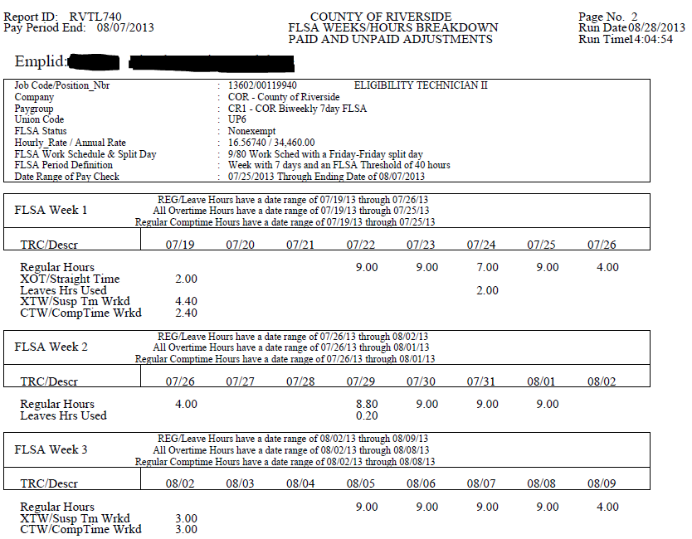
RVTL740

Slide 18
my|CalPERS Update
Letitia Graves, CPP
Senior Accountant

Slide 19

my|CalPERS
www.calpers.ca.gov
Members have access
Will provide real-time data
Annual Member Statements are available online. They will no longer be mailed unless you “opt in”

Slide 20
Retirement Rates
CalPERS Contribution Rate changes in FY13/14
  Each fiscal year our employer contribution rates change effective with the payroll period that includes July 1. FY13/14 rates changed on PP15-2013.
  County Miscellaneous rate increased to 8.927%
  County Safety rate increased to 13.827%
  Flood rate increased to 17.701%
  Parks rate increased to 17.441%
  Waste rate increased to 20.579%

Slide 21
OASDI Modification
  CalPERS determined PEPRA (Tier3) should not have the OASDI modification. Effective PP18-2013, the OASDI modification was eliminated in HRMS on benefit plans EEP67, FEEP67, and PEEP67 related to MISCT3 deduction code.
  The OASDI modification/offset is a $61.54 reduction of the reportable earnings to calculate the member contribution amount for the employees who pay into Social Security, except PEPRA employees.
    $61.54 x 8% = $4.92 reduction of member-paid contributions
    $61.54 x 7% = $4.31 reduction of member-paid contributions

Slide 22
Retirement
Approximately 96 PERS Retirement Benefit Plans
Total of 54 deduction codes flow into the PERS Fund
Making up our $8.074M bi-weekly payment
We are currently down to reporting issues on 13 of 167 employees

Slide 23

National Payroll Week (NPW)
September 2-6, 2013
Diane Wong, CPP, CPA
Senior Accountant

Slide 24
National Payroll Week
Was founded by the American Payroll Association (APA) in 1996. It is held annually during the week of Labor Day, hosted by APA
Goals of NPW:
  Honor the working people who work and pay taxes
  Honor the payroll professionals for their work
  Increase public awareness of the role tax contributions
  Increase public awareness of the payroll professionals in ensuring that workers receive what is rightfully theirs
  Provide public service education to the teens and workers about their paychecks, the withholding systems, child-support withholding obligations, and payroll-related benefits

Slide 25
National Payroll Week
NPW celebrates the hard work of the 156 million wage earners and their tax contributions
Through the payroll withholding system and the payroll professionals who pay them, they collect, report and deposit approximately $1.78 trillion, or 70.5%, of the annual internal revenue of the U.S. Treasury (source: APA)

Slide 26
2012 Contributions at a Glance
Together with all the processing functions from Department Representatives, Human Resources, System Administrations, and ACO Payroll, the County produced 511,174 paychecks in which 474,909 were direct deposits in 2012
Federal Income Tax Withheld and deposited to Internal Revenue totally $127.3 million from County employees and $140.7 thousand from Special District Employees

Slide 27
Celebrate NPW
Take pride in your work
Feel good
All people who are willing to work celebrate NPW
Take the “Getting Paid in America” survey at www.nationalpayrollweek.com. A chance to win a free paycheck and a trip for two to Las Vegas
Enjoy our payroll related BINGO and win a prize
Your Prize will be delivered to you ASAP

Slide 28
Celebrate NPW
Play Payroll Lingo
BINGO!

Slide 29

Celebrate NPW
Refreshments will be served after the Open Enrollment meeting.

Slide 30
Questions??

