Slide 1

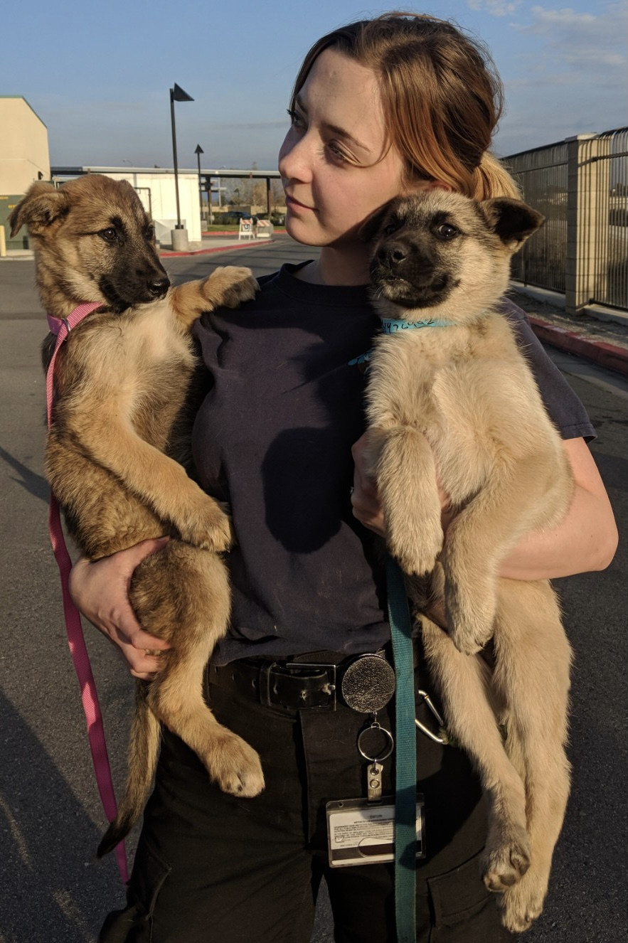


BUDGET HEARING PRESENTATION
Blythe Animal Shelter
June 2022

Slide 2
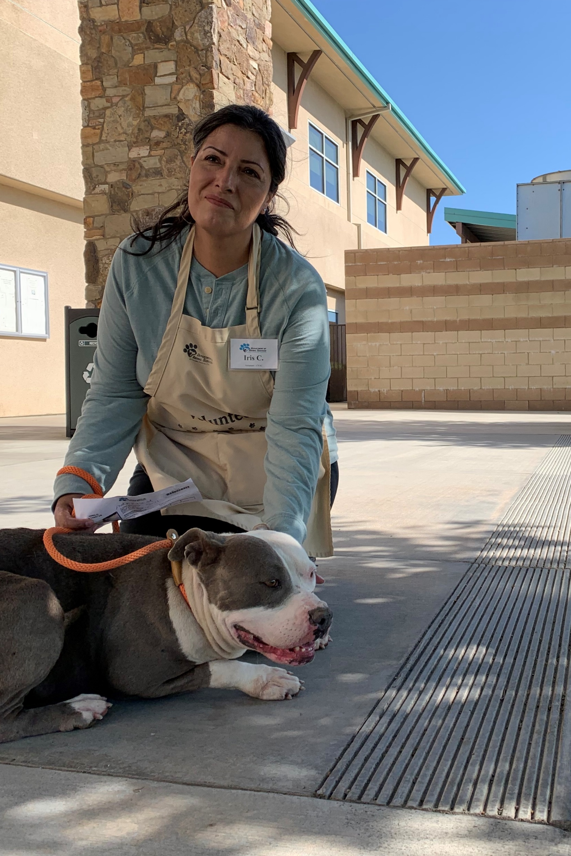

DAS BUDGET HIGHLIGHTS
Budget Request for Blythe Proposal
No Additional Requests
  FY 22/23 - Right Sizing City Contracts
    Year three (3) of fees seeking cost recovery
    Full reimbursement study completed
  Maintaining Staffing Levels
    Veterinarian
  Ongoing Shelter Over-crowding Issues
    Education
    Spay/Neuter + Vaccination + Microchip
Mission: Working together to improve Riverside County for people and animals.

Slide 3
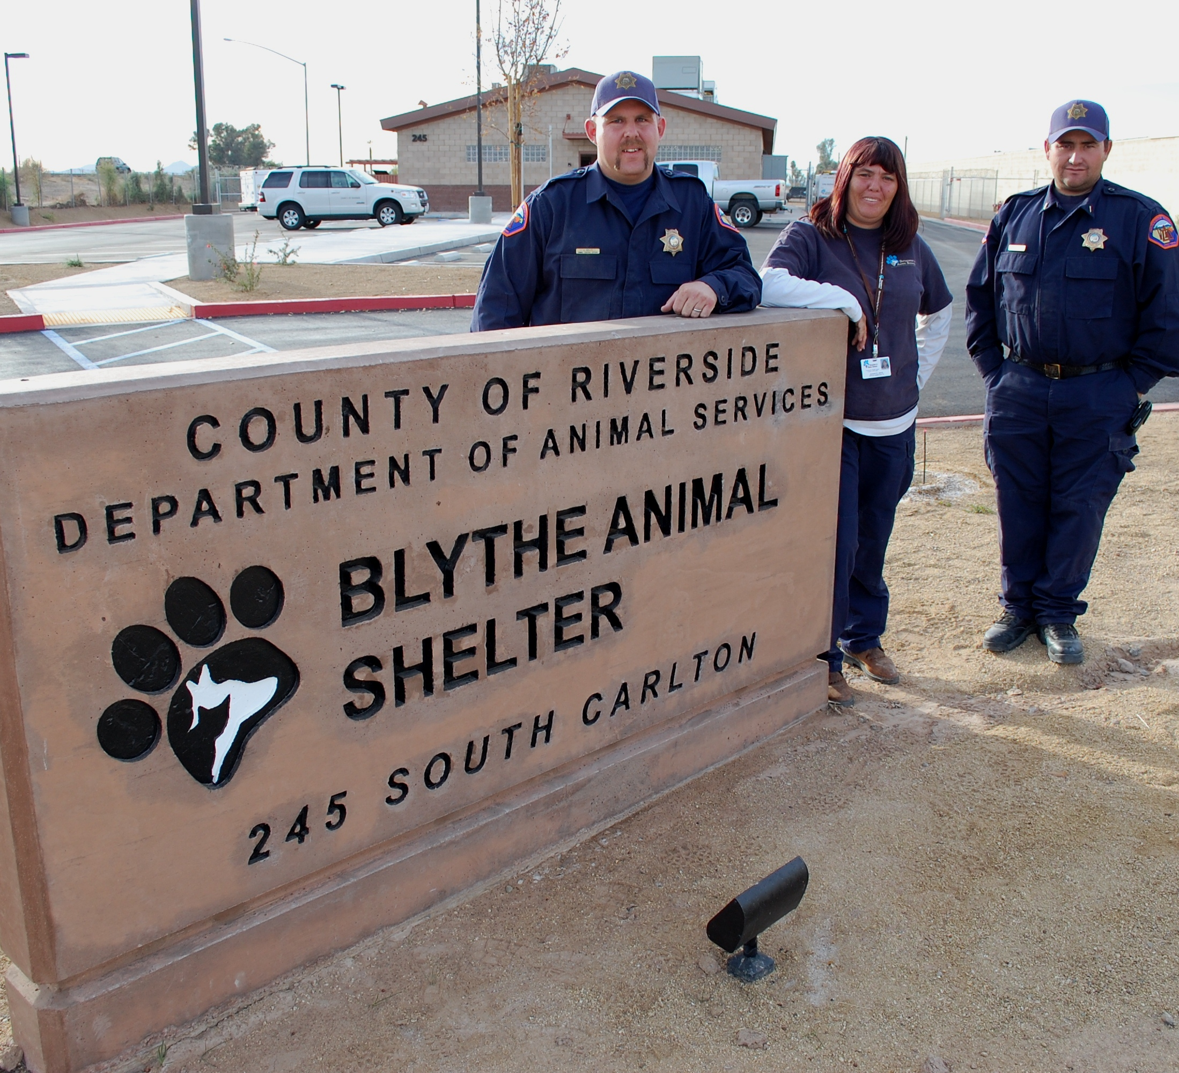
BACKGROUND
June 14, 2021
DAS proposed Blythe Shelter closure
FY 21/22
DAS working with City of Blythe
Today
Resulting Proposal
Mission: Working together to improve Riverside County for people and animals.

Slide 4
BLYTHE SHELTER PROPOSAL
DEPARTMENT OF ANIMAL SERVICES (DAS)
  Real estate transaction for transfer of property
  Contract for ACT Services
  Continue ACO Services to unincorporated areas
CITY OF BLYTHE SHELTER (City)
  Future shelter operations
Mission: Working together to improve Riverside County for people and animals.

Slide 5
1. REAL ESTATE TRANSACTION
Real Estate Transaction
  Transfer of Property
  DAS Payment to City of $300K (funding request)
Timeline
August 2022 - Future Board date to approve real estate document
Mission: Working together to improve Riverside County for people and animals.
Mission: Working together to improve Riverside County for people and animals.

Slide 6
2. CONTRACT FOR SERVICES
Contract for Services
  Duration: one (1) year, plus potential for one (1) year extension, total two (2) years.
  RivCo DAS provide one temporary (TAP) animal care technician (ACT) position for shelter service
  After transfer City of Blythe provides office space for ACO’s
Timeline
August 2022 - Future Board date to approve contract
Mission: Working together to improve Riverside County for people and animals.

Slide 7
3. SERVICES TO UNINCORPORATED +
4. FUTURE SHELTER OPERATIONS
Continued Service to Unincorporated areas in Eastern County
  DAS to provide Animal Control Officers (ACOs) for services
  After 1-2 year service contract City provides office space agreement to DAS
Shelter Operations for City of Blythe
City to work with an organization to provide services at City’s discretion
Mission: Working together to improve Riverside County for people and animals.

Slide 8
DAS FUNDING REQUEST
$300,000 Budget Adjustment Request
  One time payment to City of Blythe
  City intends to use for deferred maintenance, such as:
    Air Conditioning System – replacement
    Retaining Wall – parking lot
    Sewer Waste Trap – decaying vault
Mission: Working together to improve Riverside County for people and animals.

Slide 9
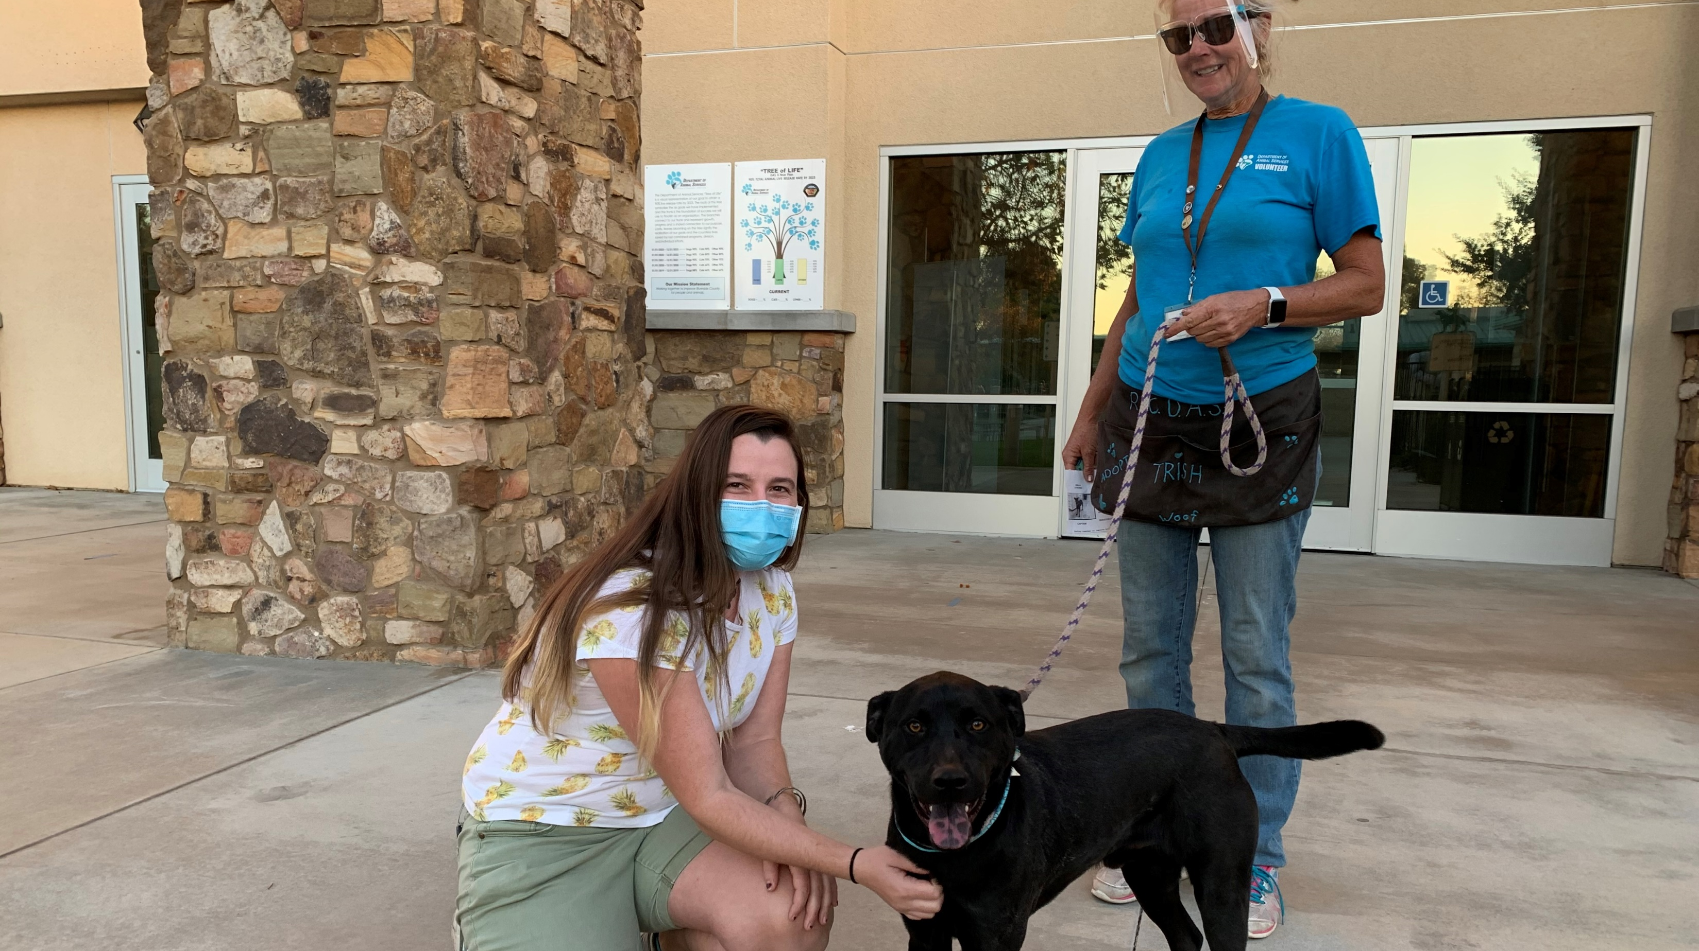
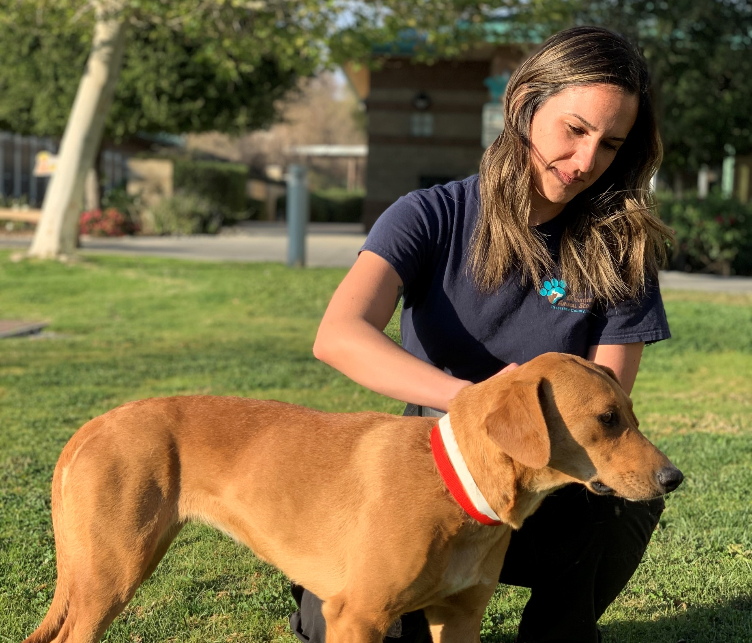
Any Questions?
Mission: Working together to improve Riverside County for people and animals.

Slide 11
ANNUAL COSTS
Annual Cost to operate the Blythe Animal Shelter
  Average facility cost/year over three years: $156,000
  Approximate Staffing Cost $286,000 to $490,573
  TOTAL $442,000 to $646,573
Mission: Working together to improve Riverside County for people and animals.

Slide 12
ACTIVITIES FOR SHELTER OPERATION
Activities City or City partner would assume (after service contract):
Animal adoptions
Foster programs
Veterinary care for sick or injured animals
Spay/neuter for all animals adopted as required by the State of California
Vaccination and licensing enforcement, rabies control
Working with animal rescue organizations
Animal care and husbandry
Euthanasia
Volunteer program
Mission: Working together to improve Riverside County for people and animals.

Slide 13
DEFERRED MAINTENANCE
Cost of Deferred Maintenance
  Sewer Waste Trap – decaying vault $30,000
  Retaining Wall – parking lot $100,000
  Air Conditioning System – replacement $250,000 to $500,000
  TOTAL $380,000 to $630,000
  Other items
    Surveillance – camera system $10,000
    Security Barrier – front counter $20,000
    Panic Buttons – new system $15,000
    Water Conditioning - installation $80,000
    ADDITIONAL TOTAL $125,000
Mission: Working together to improve Riverside County for people and animals.

Slide 14
CITY OF BLYTHE CONTRIBUTIONS
Annual Contributions of the City of Blythe
  FY 14/15 $50,735
  FY 15/16 $50,071
  FY 16/17 $50,071
  FY 17/18 $50,071
  FY 18/19 - 393 animals $41,036
  FY 19/20 - 343 animals $34,519
  FY 20/21 - 144 animals $15,934
  FY 21/22 - 296 animals thru 5/31/22 $48,375+ (more once ratified)
Mission: Working together to improve Riverside County for people and animals.

