Slide 1
Who We Serve
79 RUHS Operated Sites
140 Community Based Org Sites
100+ School Sites
60,000+ consumers cared for annually across our service array (MH, SAPT, Housing, Detention, Crisis)

Slide 2
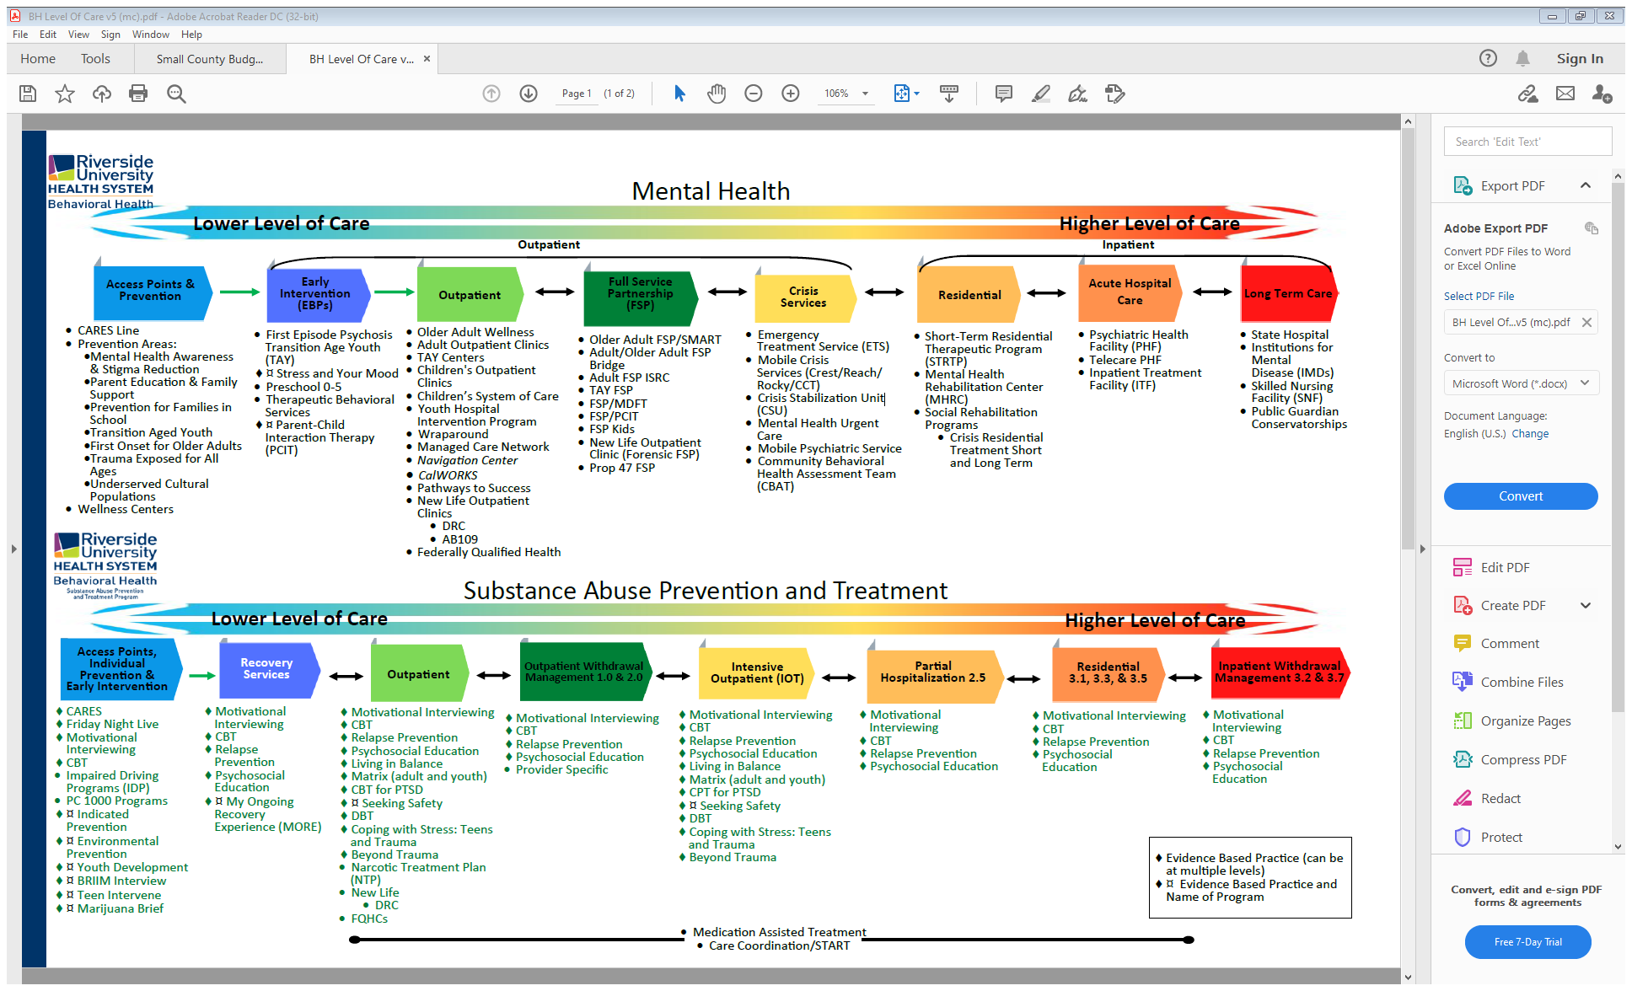

Slide 3
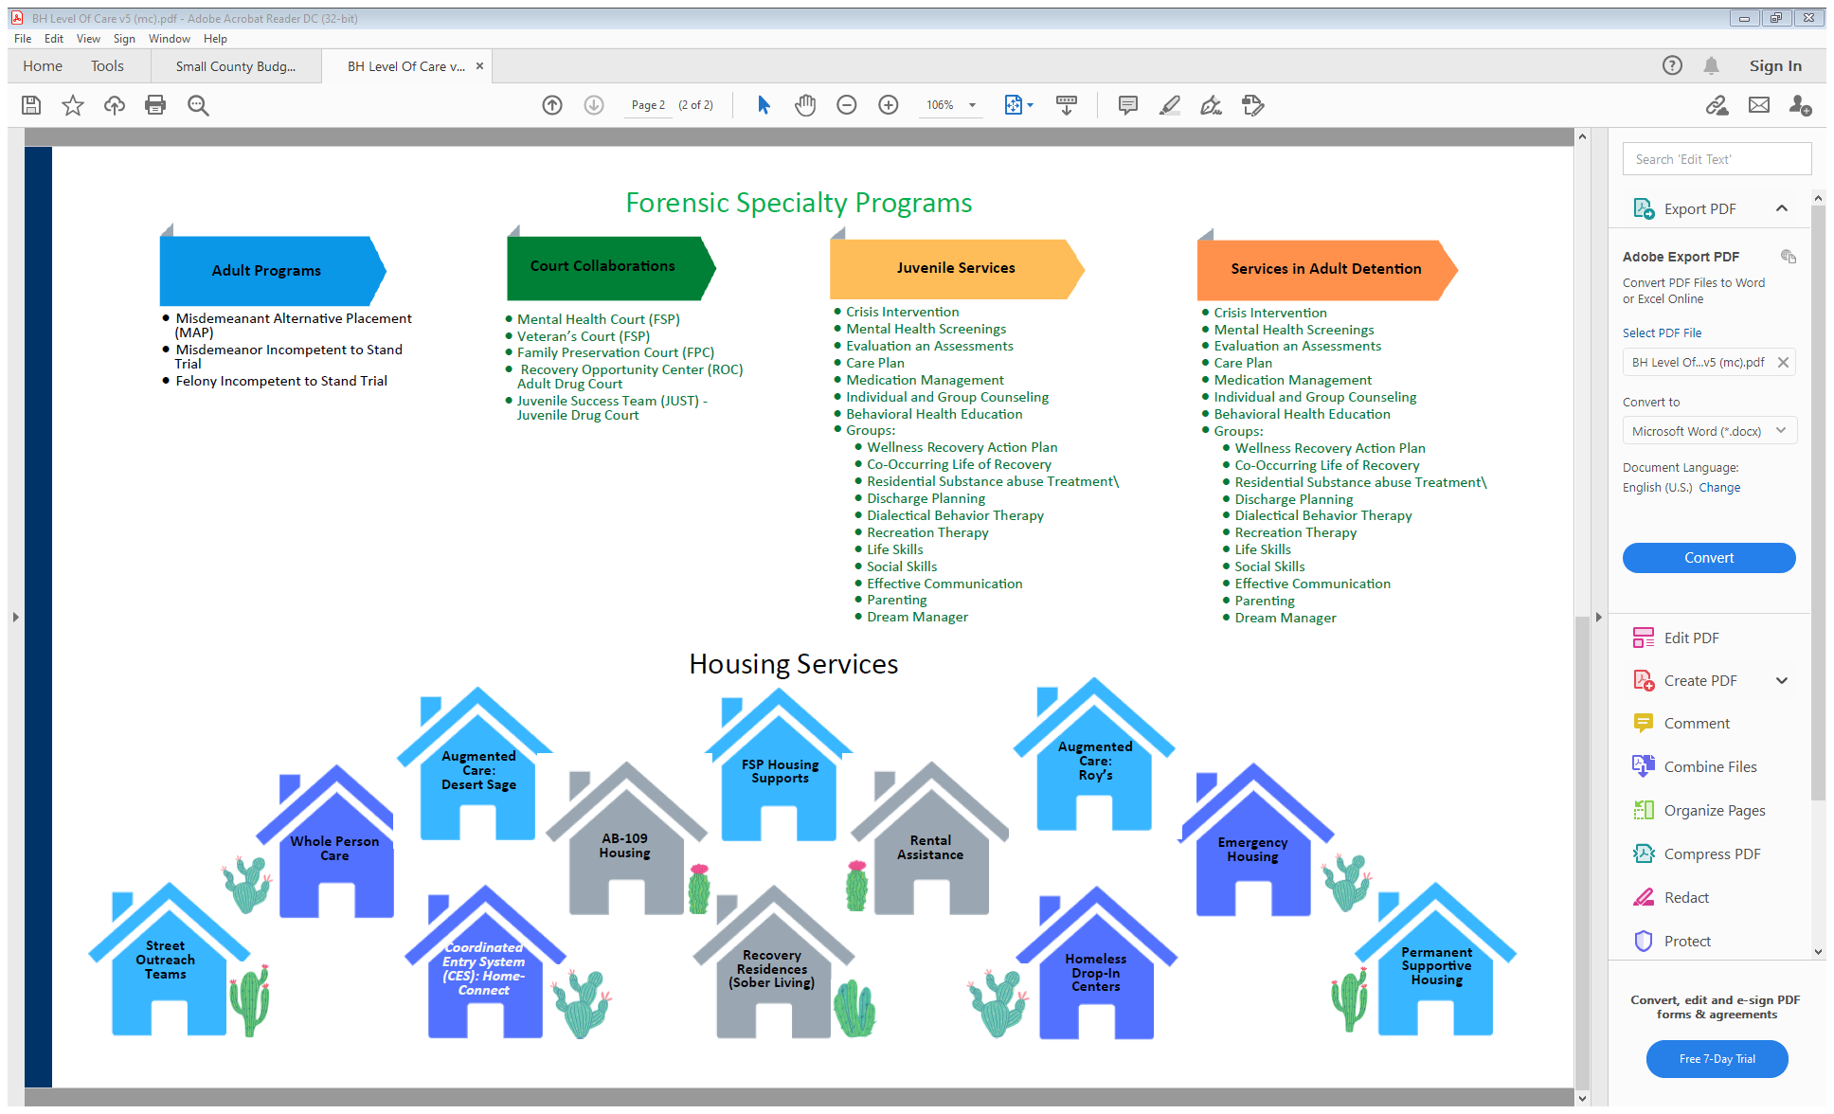

Slide 4
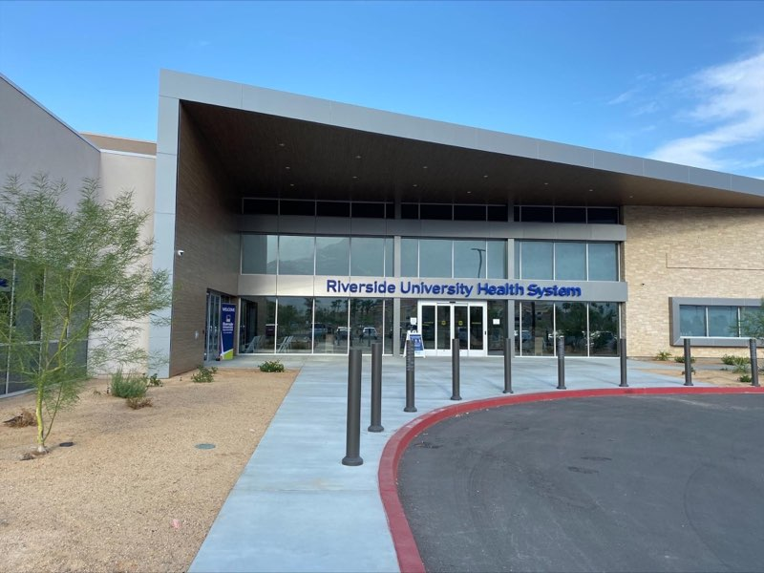
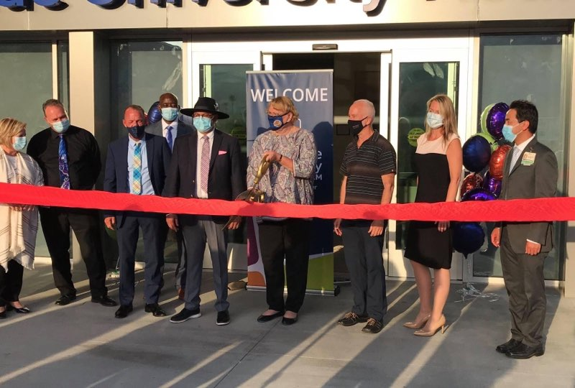
RUHS Palm Springs CHC

Slide 5
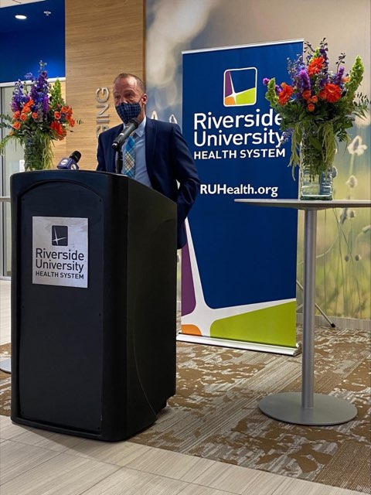
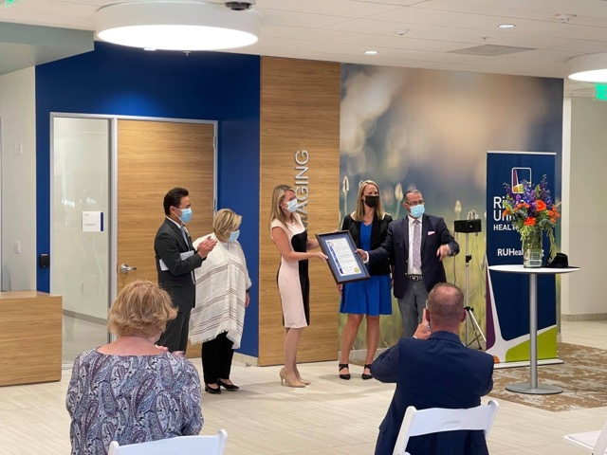
RUHS Palm Springs CHC

Slide 6
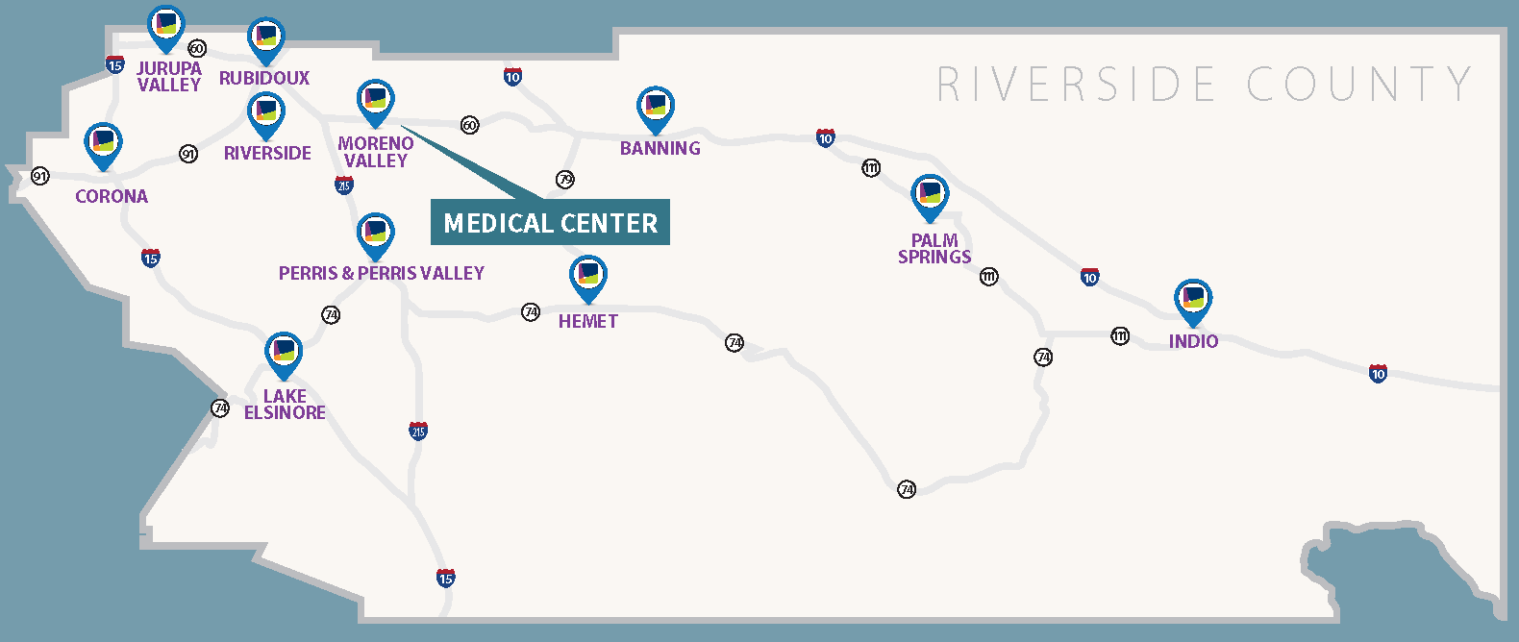

Slide 7
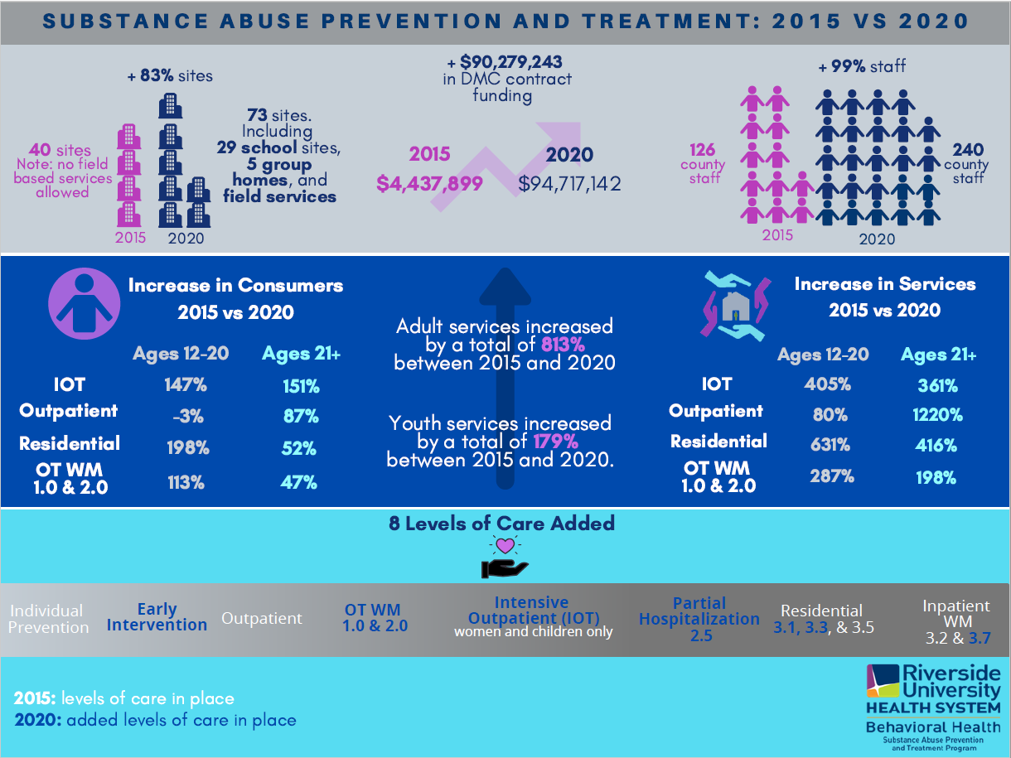

Slide 8
Leveraging/Grants
NPLH ($49.2M)
CSI rounds 1 ($4M) and 2 ($18.9M)
Crisis Care Mobile Unit Rounds 1-3 ($15.2M*)
CHFFA Children/Youth Grant ($395K)
DSH IST ($8.1M) and IST Housing
BHCIP Planning ($150K)
Mentored Internship Program ($885K)
Behavioral Health Justice Intervention ($700K)
Sierra Health Telehealth ($590K)

Slide 9
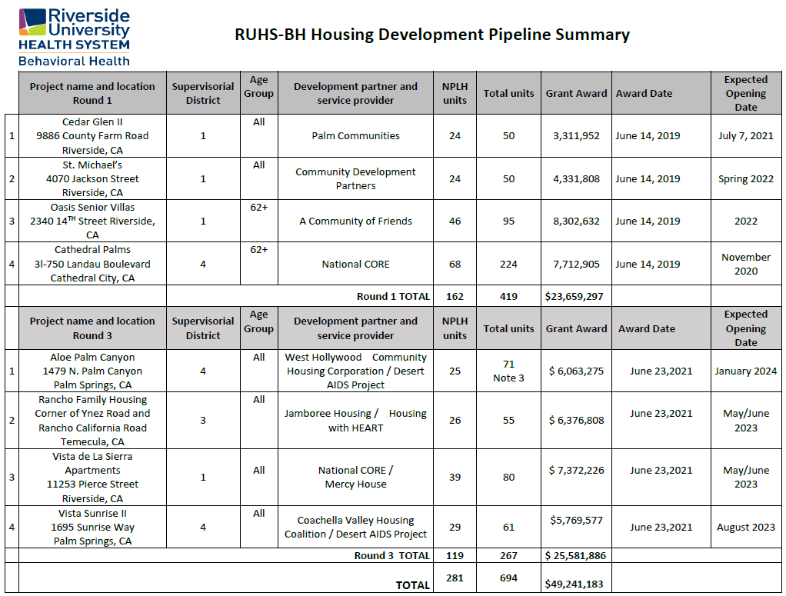
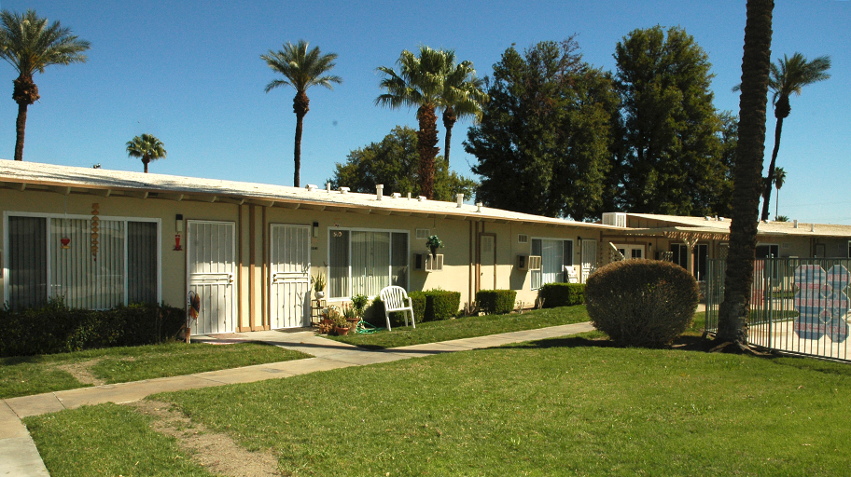
No Place Like Home

Slide 10
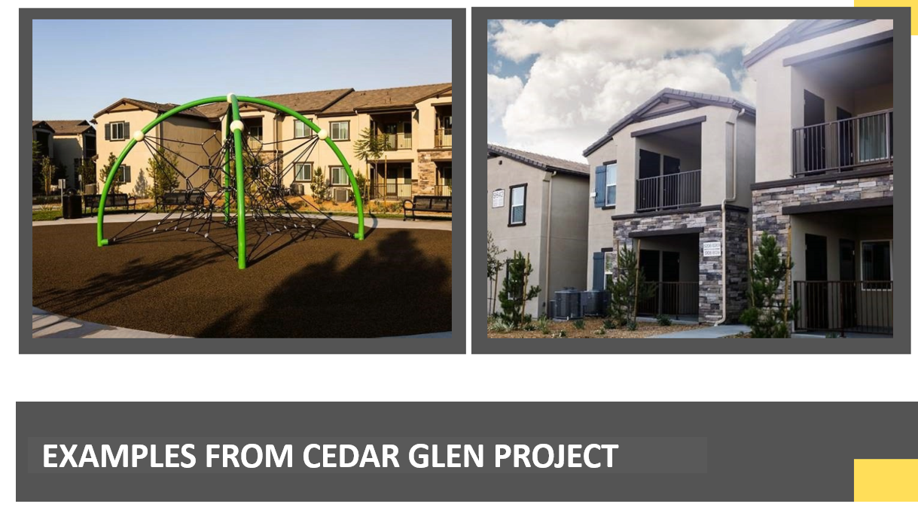

Slide 11
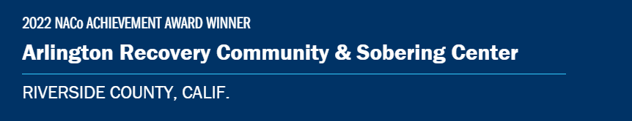
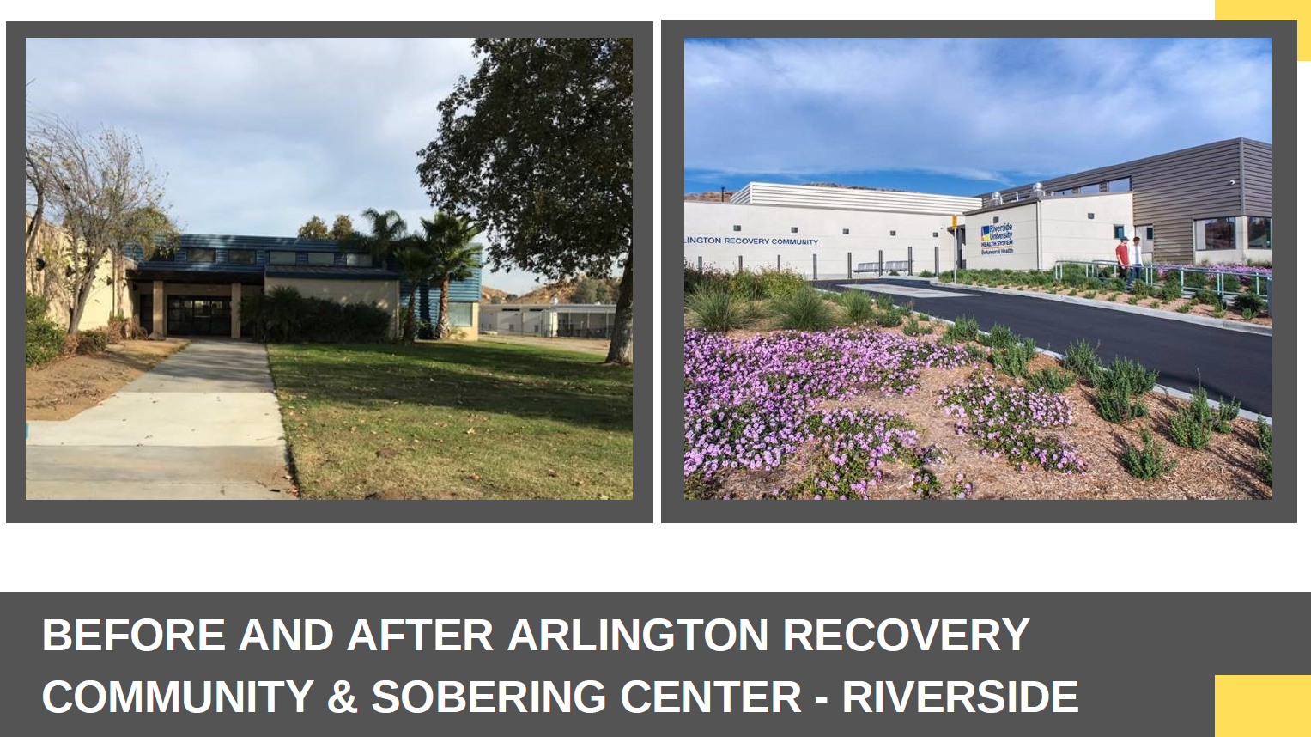

Slide 12
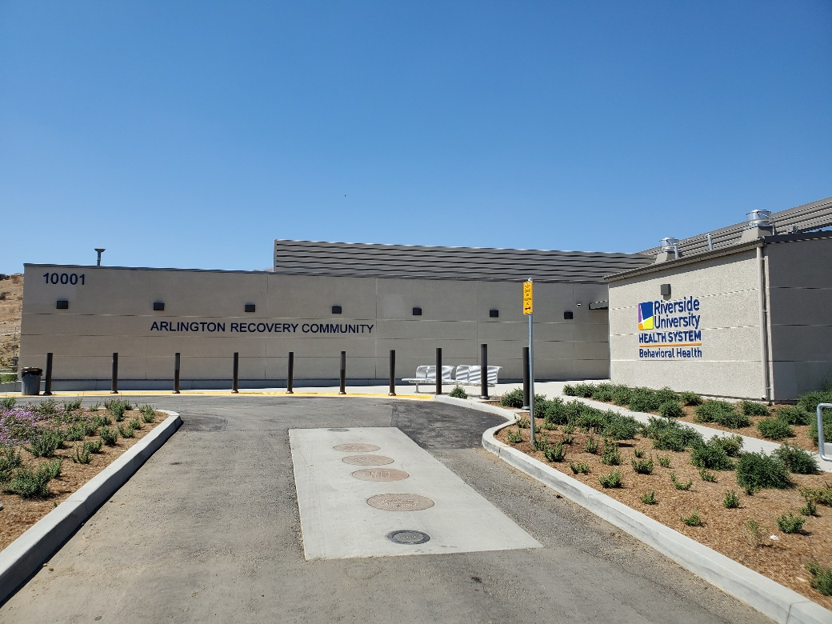
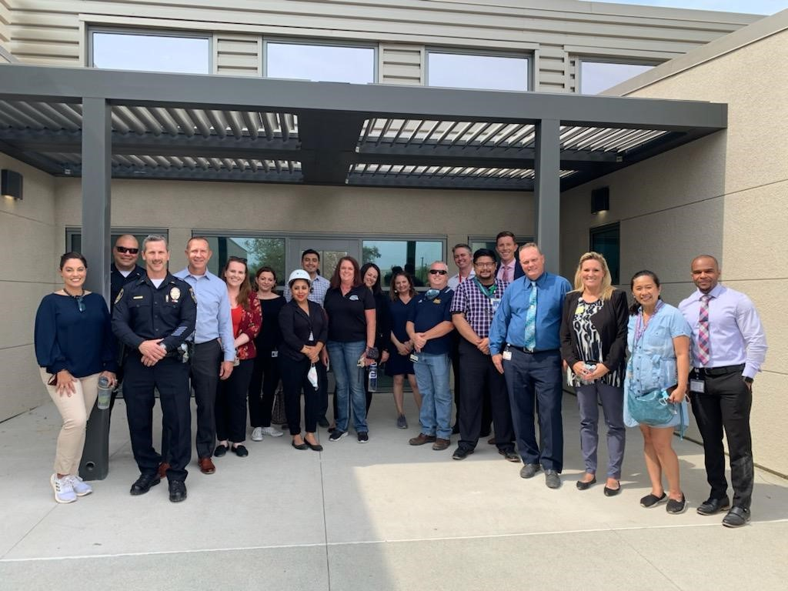
Arlington Recovery Community (ARC) and Sobering Center

Slide 13
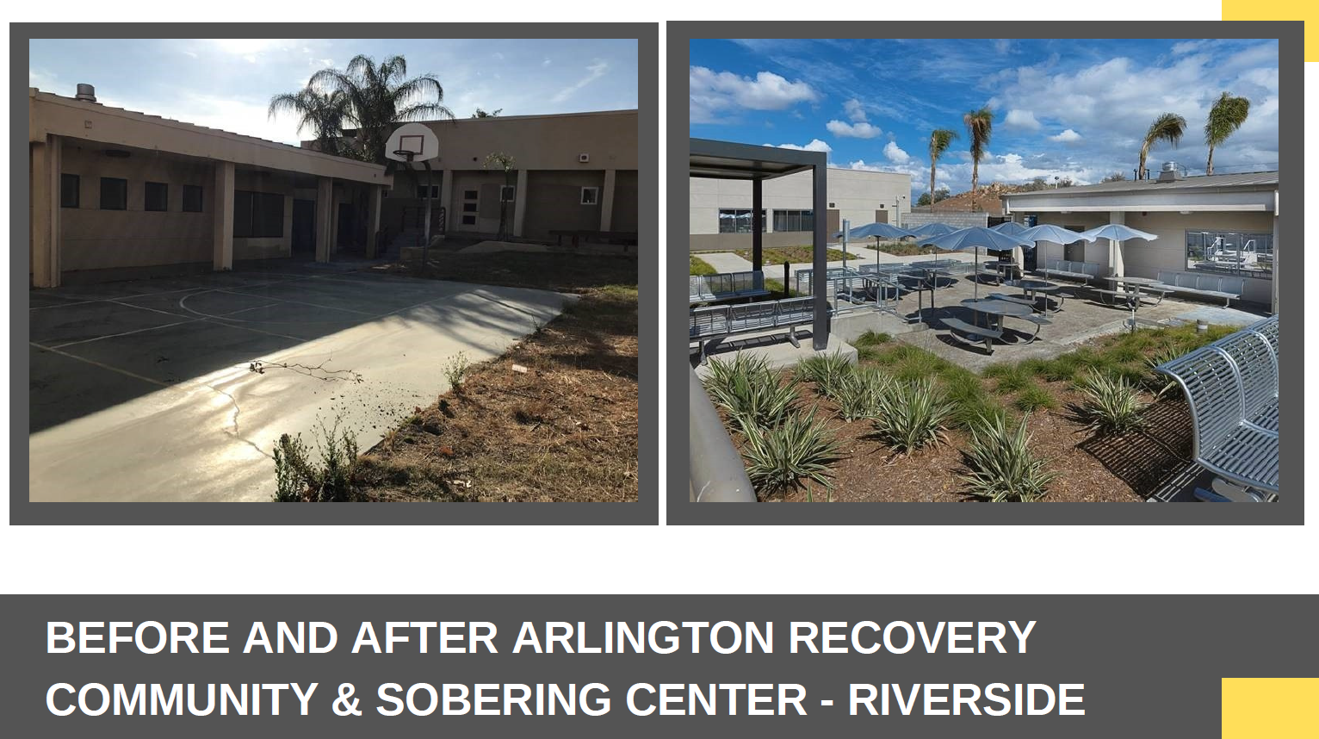

Slide 14
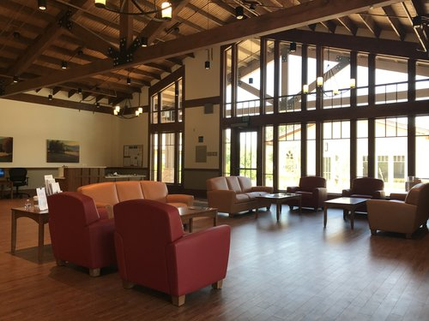
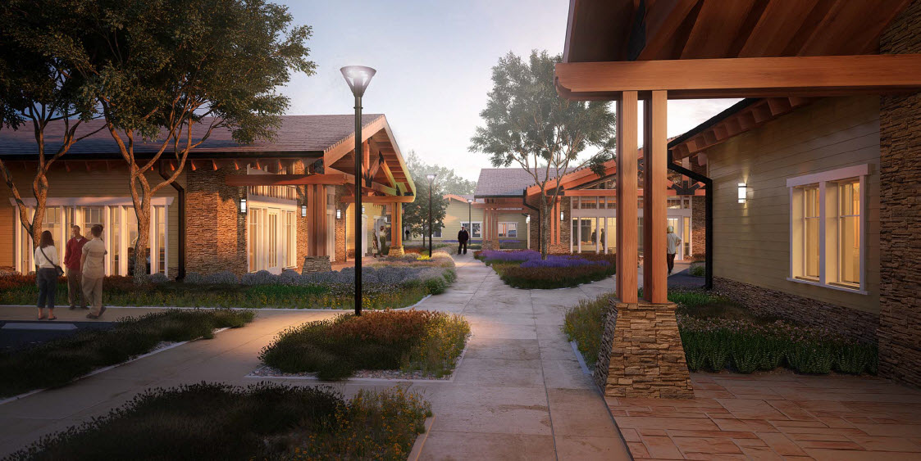
Crisis Campus

Slide 15
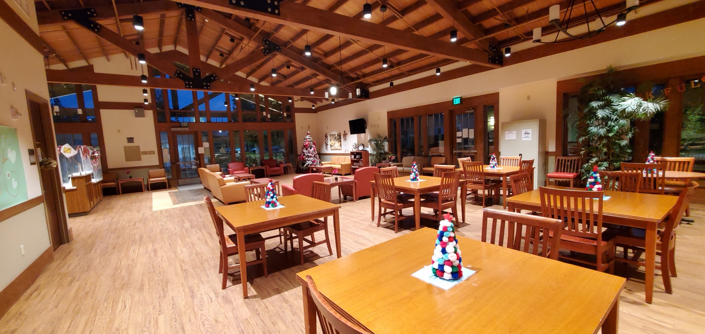

Slide 16
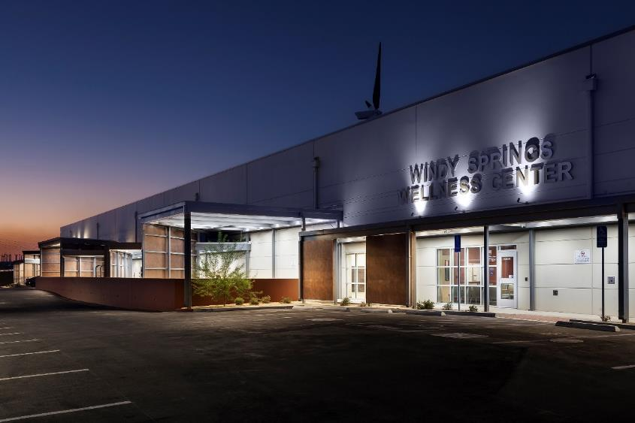

Slide 17
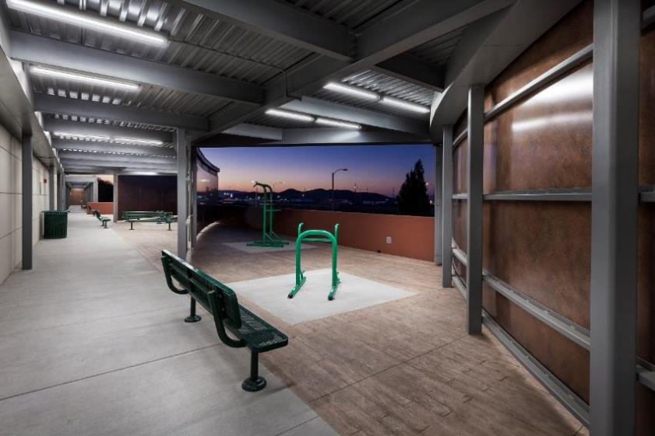

Slide 18
Recent Continuum Buildout
  Roy’s Desert Springs: Augmented Board and Care
    92 beds
  Mental Health Rehabilitation Center
    59 beds
  NPLH
    Cathedral Palms 68 beds for seniors, Cedar Glen 39 beds
  ARC/Sobering center
    54 beds for individuals with SUD

Slide 19
Recovery Villages

Slide 20


Slide 21
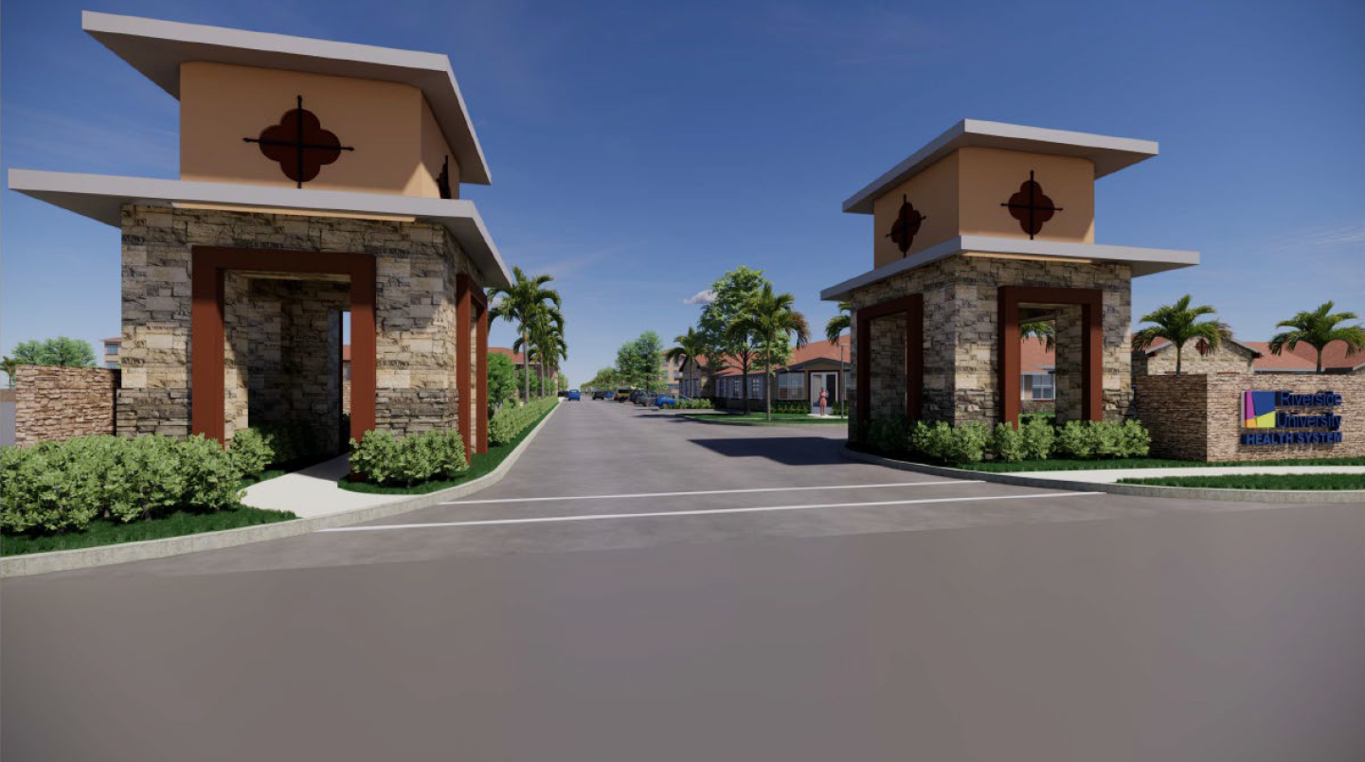

Slide 22
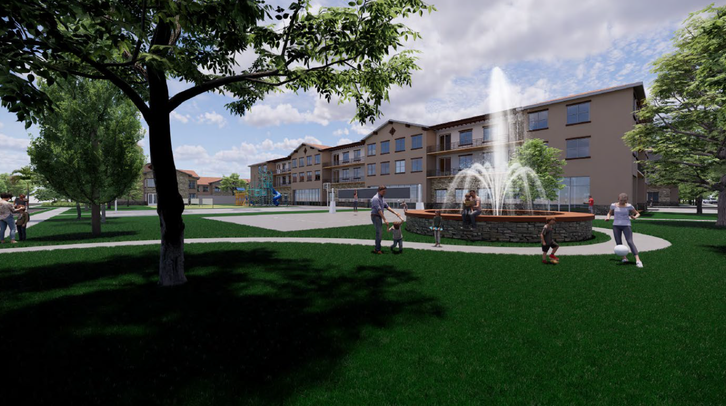

Slide 23
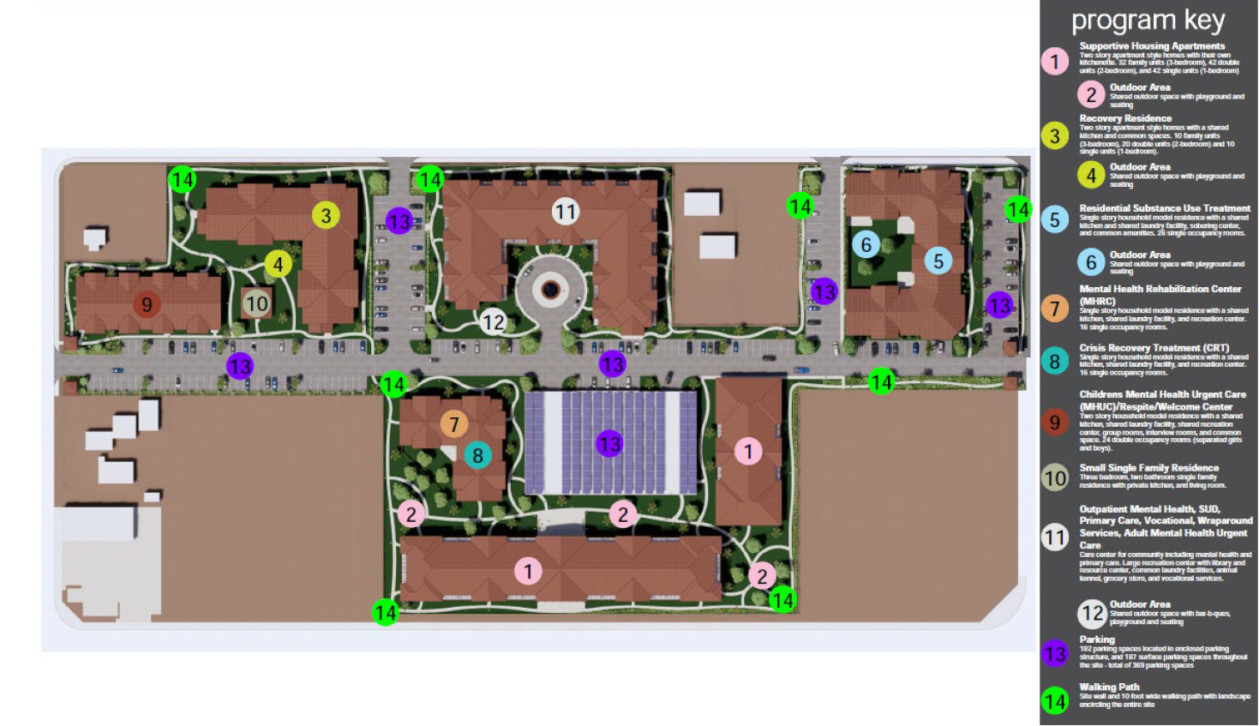
Variations from proposed plan include a 50-bed MHRC and a 90-bed Adult Residential Facility

Slide 24
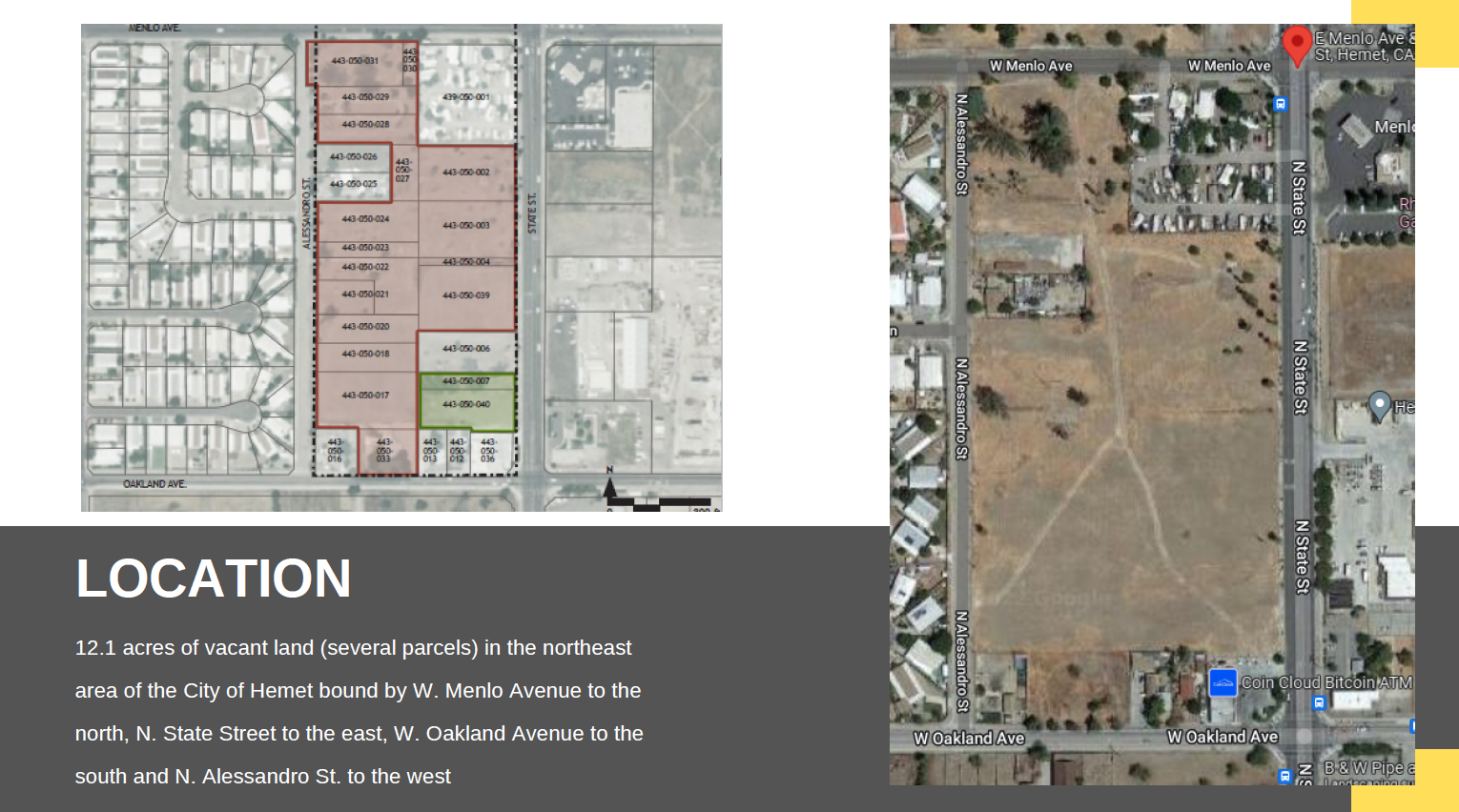

Slide 25
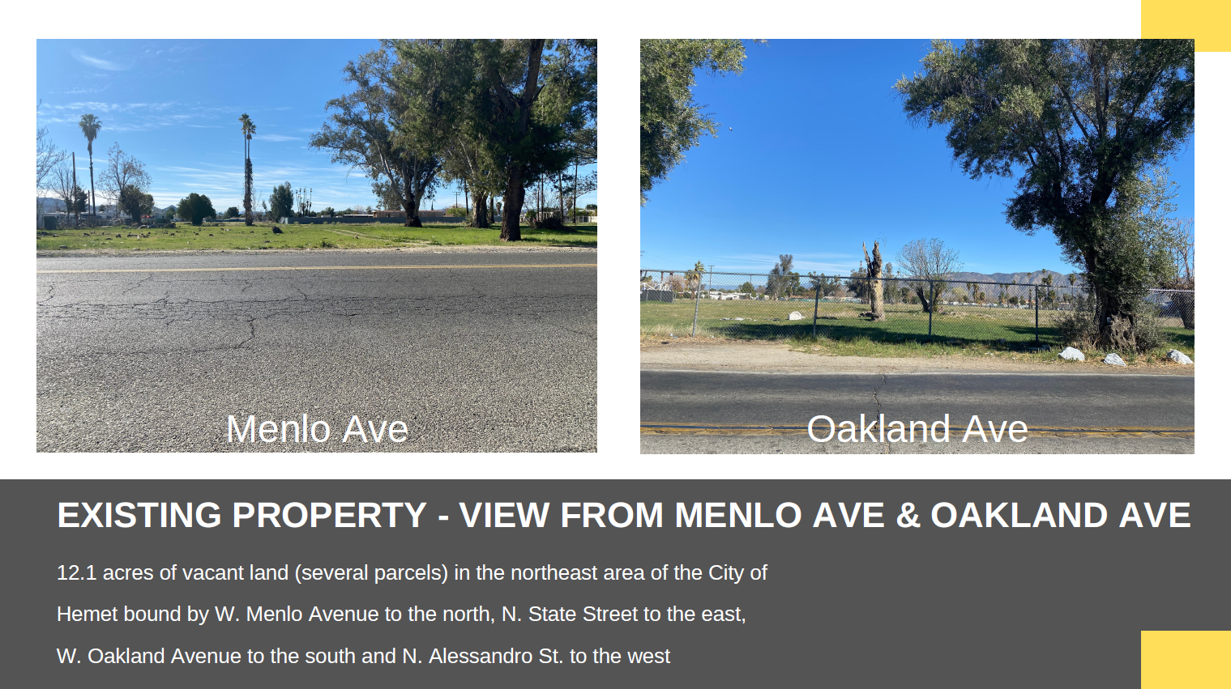

Slide 26
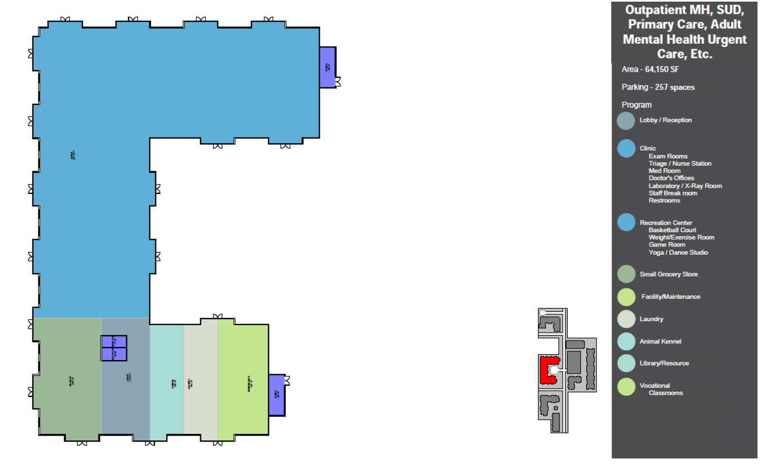

Slide 27
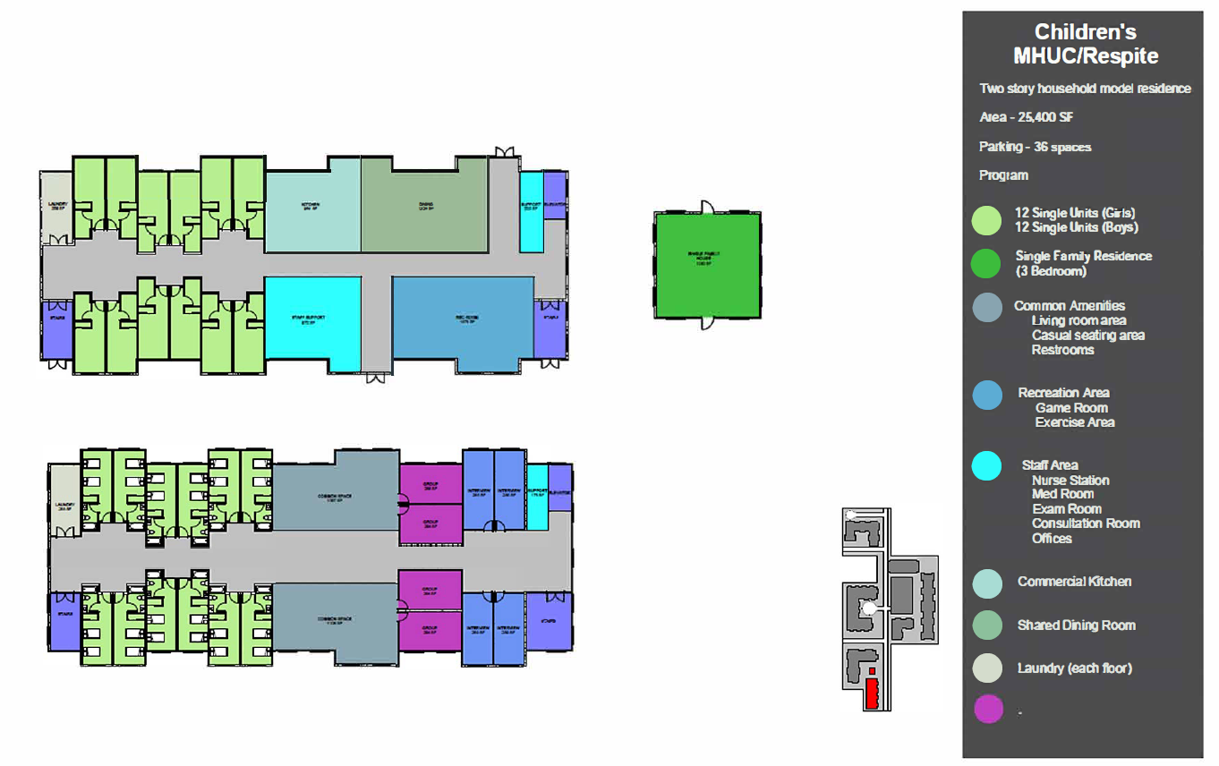

Slide 28

PROPOSED

Slide 29
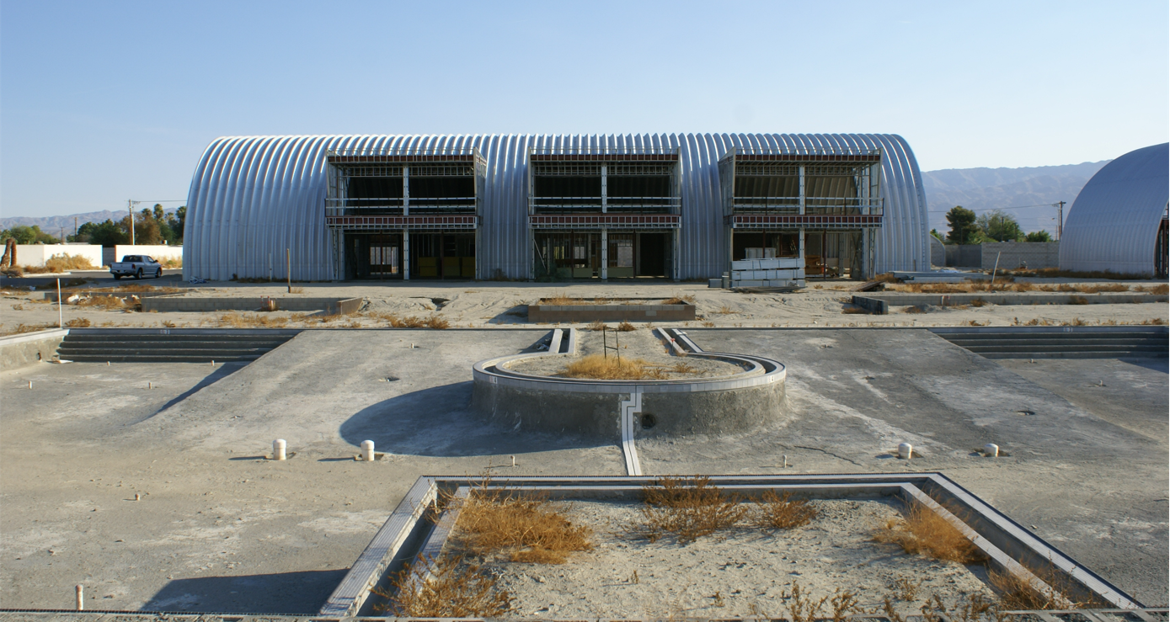
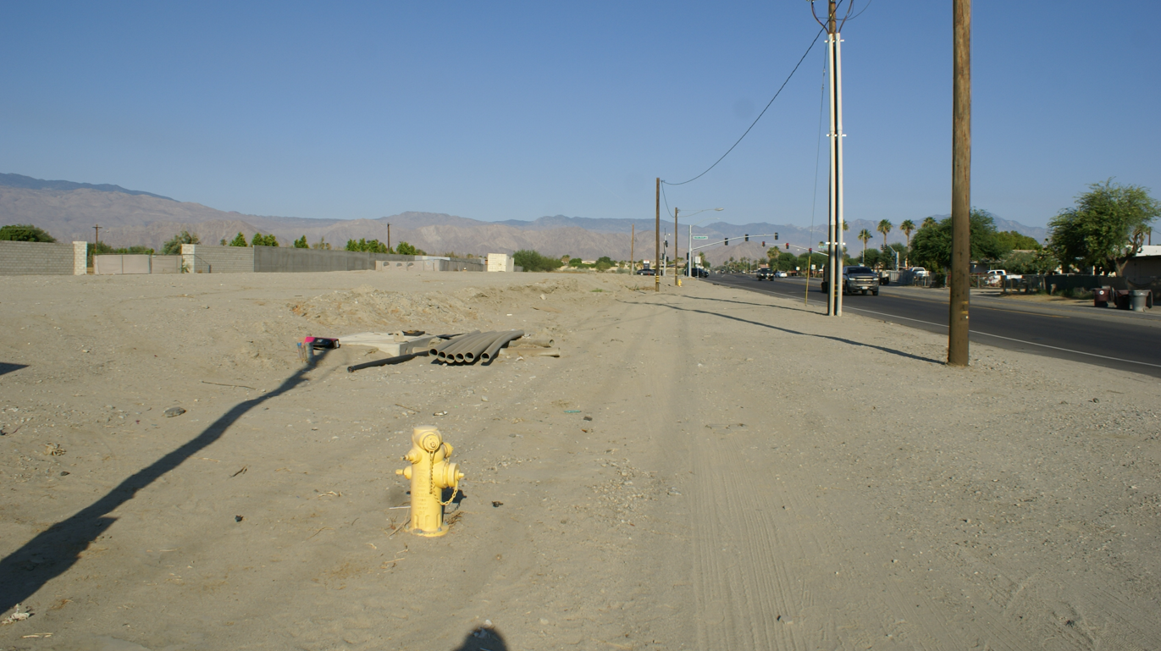
EXISTING PROPERTY

Slide 30
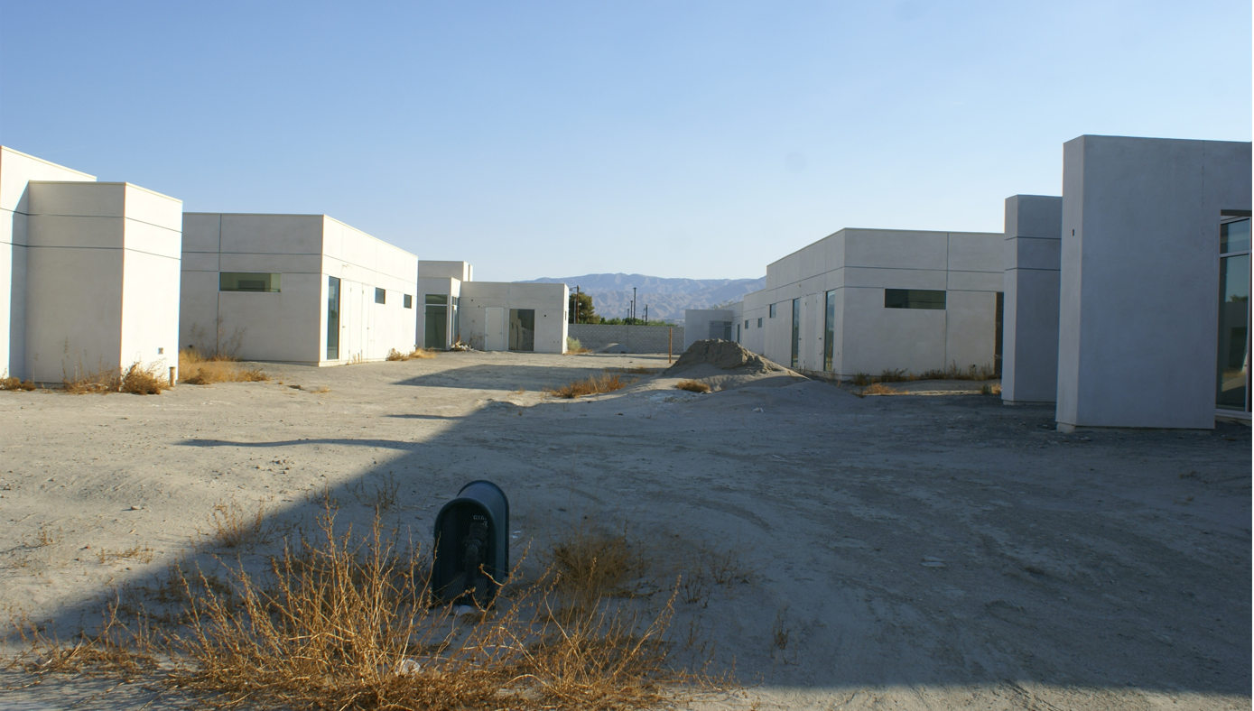
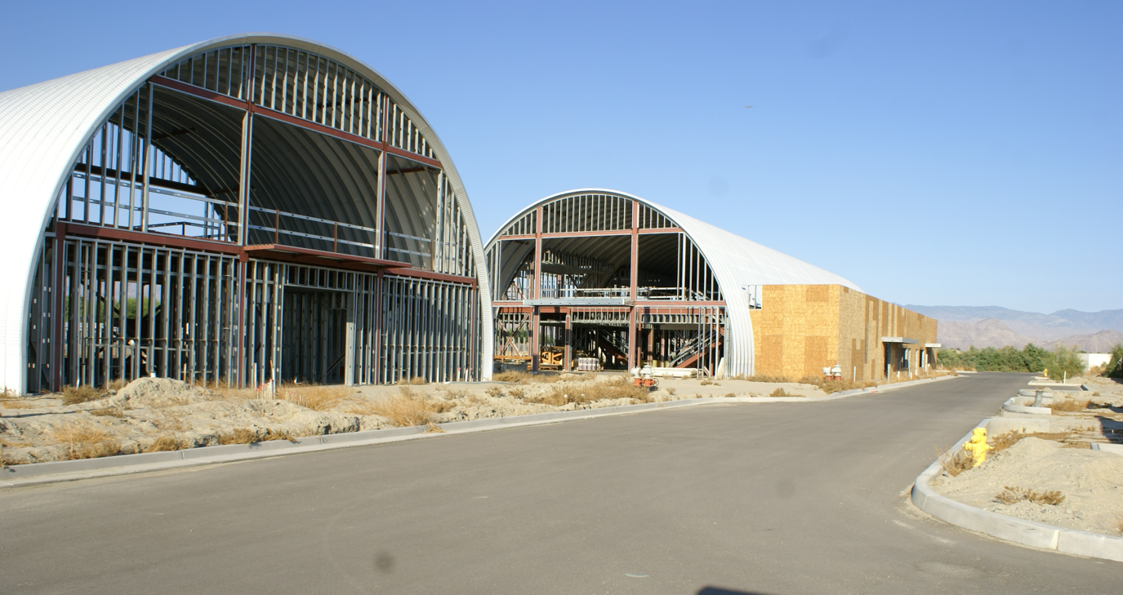
EXISTING PROPERTY

Slide 31
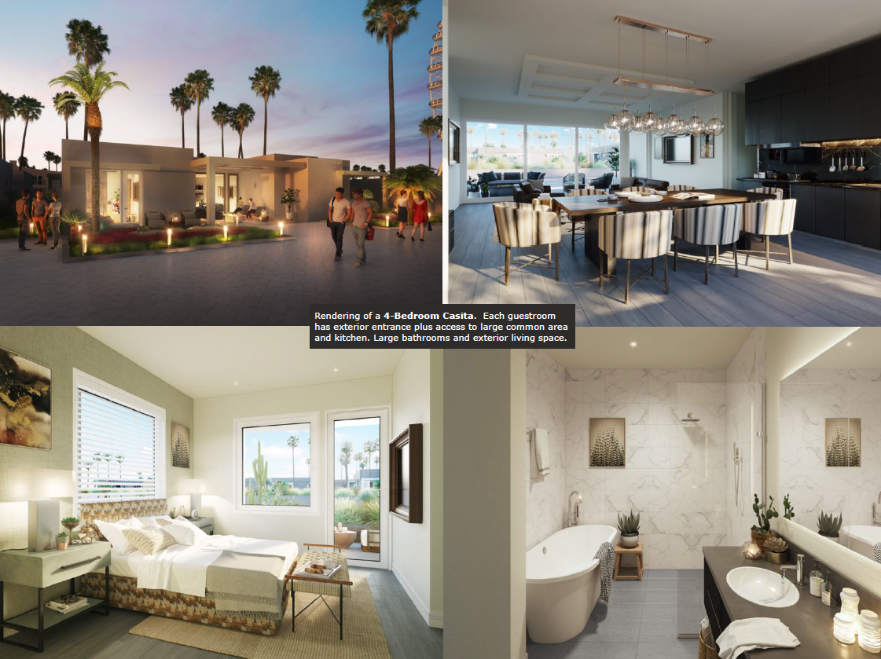

Slide 32
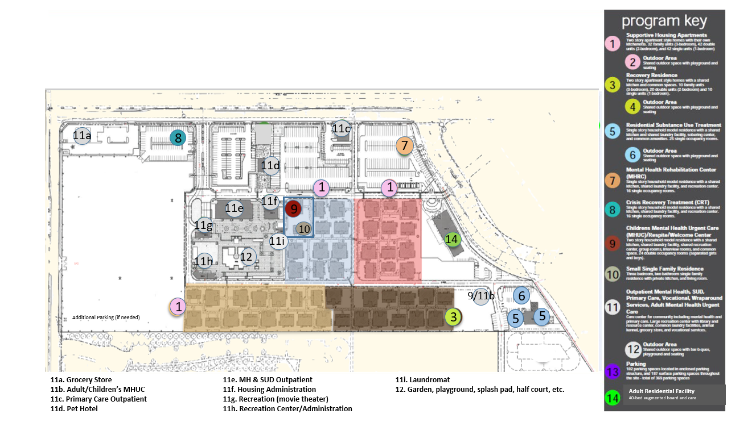

Slide 33
Recovery Villages Update

Slide 34

Additional NCC Request
Recovery Village Continued Planning and Design $1,000,000
Public Guardian Caseload, Rising Labor & ISF Costs $ 713,590
Total NCC Request $1,713,590

Slide 35
$400,000,000

Slide 36


