Slide 1
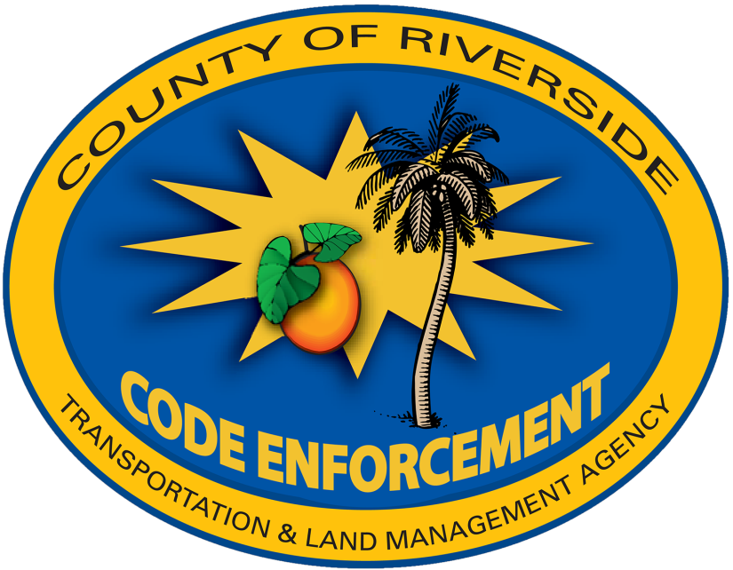


Code Enforcement Department
Combustible Materials Task Force (CMTF)
June 2022

Slide 2
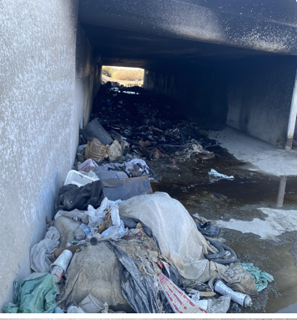
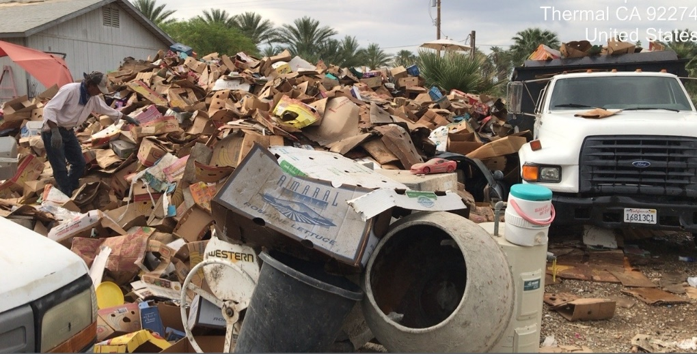
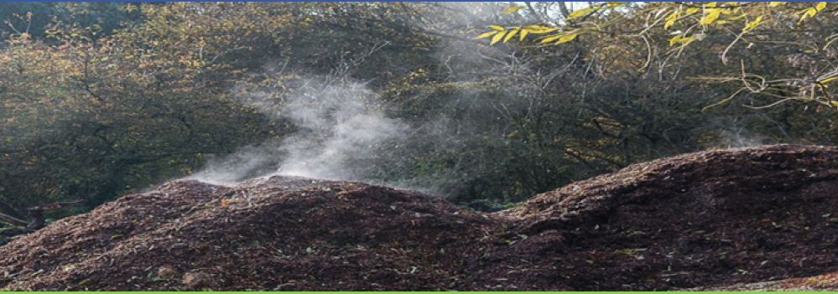
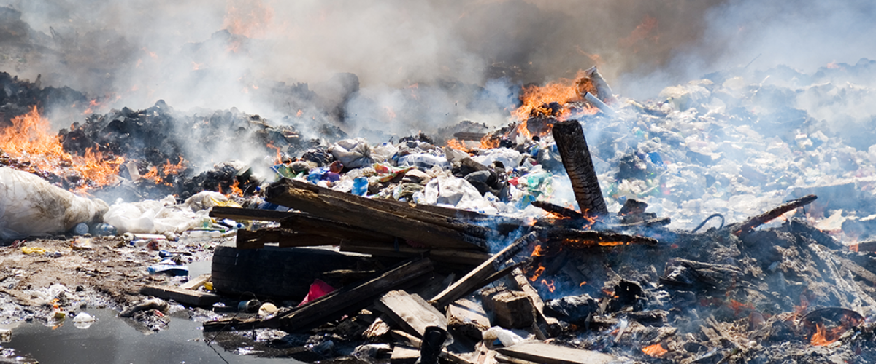
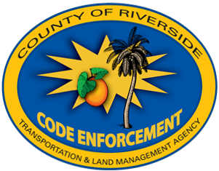
Combustible Materials Task Force
Formed in 2019 to reduce the risk of fires in the unincorporated areas of eastern Coachella Valley stemming from:
  Green waste
  Mulch
  Illegal dumping
  Homeless Encampments
June 2022

Slide 3
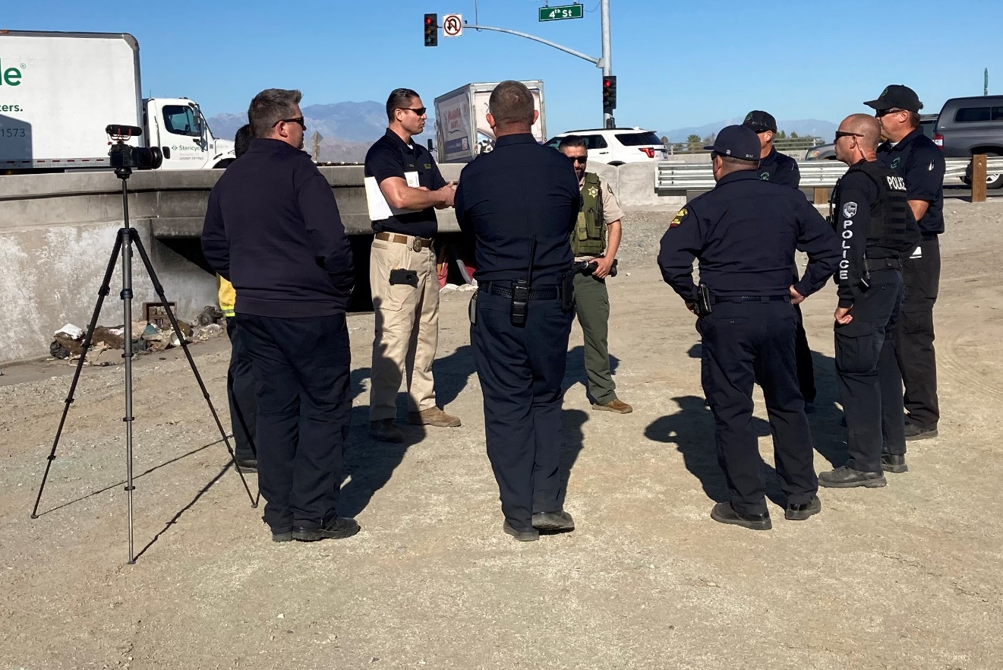
Code Enforcement’s Role
Project manager – lead on collaborative projects
Public education and outreach
Maintain records and stats
Contact property owners and hold them accountable
Assure compliance is achieved
Partner with other TLMA Departments – Building & Safety, Planning and Transportation
June 2022

Slide 4
Code Enforcement Resources
1 Code Enforcement Officer II
  1 Supervisor
  Clerical Support
  Additional field staff as needed
Approx. 1250 hours of lead officer casework time (to date)
Code Enforcement receives majority of agency referrals
Code Enforcement provides pro-active outreach, education
June 2022

Slide 5
CMTF Results
290
June 2022

Slide 6
Code Enforcement Budget
  The Department requests a budget increase of $175,000
  Increased funding will allow for pro-active patrols to identify hazards sooner
  Added funding will allow a full-time dedicated staff person for CMTF
  Focusing assignments will increase productivity
June 2022

Slide 7

Combustible Materials Task Force
Code Enforcement Department
Transportation Department
Fire Department
Environmental Health
County Counsel
RUHS Behavioral Health
South Coast AQMD
Other community partners
June 2022

Slide 8


Questions?
Discussion…

Slide 9


