Slide 1

Michael A. Hestrin
District Attorney
FY 22/23 BUDGET PRESENTATION
June 13, 2022

Slide 2
YOUR DISTRICT ATTORNEY’S OFFICE
Serving the 4th largest population in CA in the nation’s 10th largest county with approximately 2.5M citizens in 28 cities and unincorporated areas:
Locations: 4 regional offices (East, West, South-West and Mid-County) and 2 satellite offices (Blythe, Juvenile)
Current Staff: 737 employees (includes 47 candidates in background) including attorneys, investigators, victim services advocates, technicians and support staff.
Current Operating Budget: $157.8M ($85.4M non-NCC)

Slide 3

Accomplishments
Combating Fentanyl Related Crimes
Riverside County Regional Cold Case Team
Advances in Technology
Collaboration/Innovation in Criminal Justice:
  Homeless Court
  Veterans Treatment Court
Countywide Task Forces:
  RCCET
  GIT

Slide 4
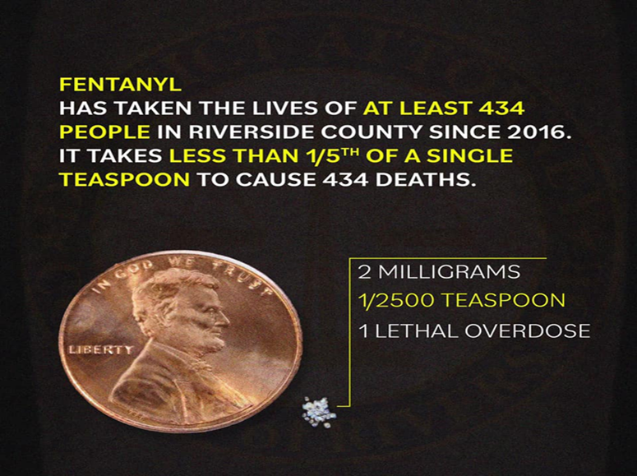
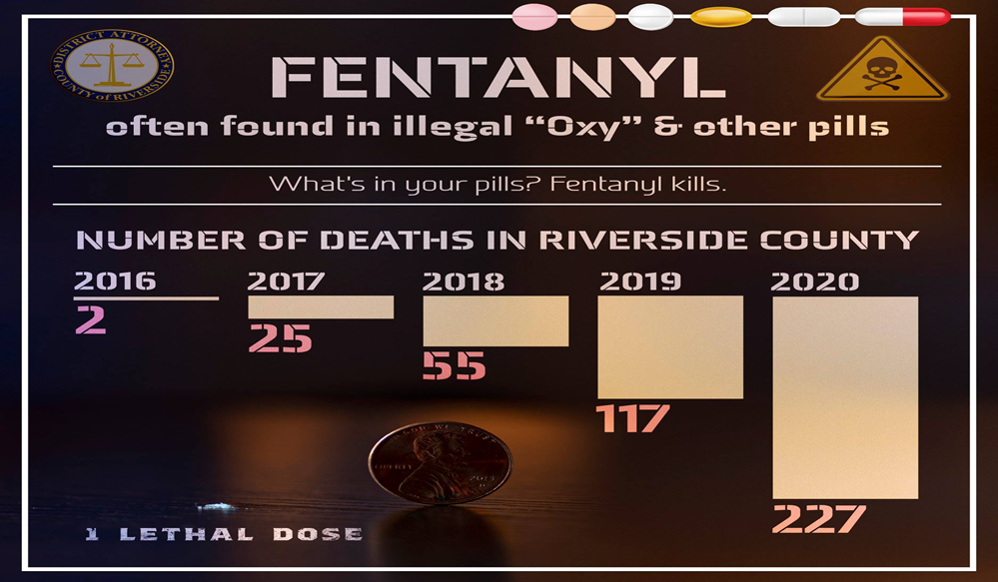
COMBATING FENTANYL RELATED CRIMES
RIVERSIDE COUNTY HAS 20 ACTIVE CASES INVOLVING FENTANYL RELATED DEATHS

Slide 5
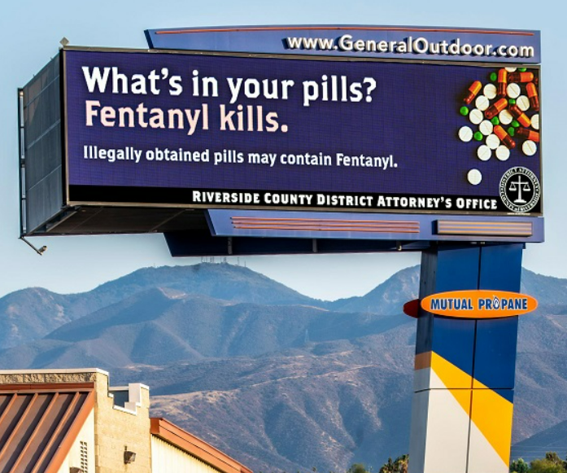
Combating Fentanyl in the Community
  Multidisciplinary Team
  Billboards
  Public Information Campaign:
    Social Media (Facebook, Instagram, Twitter, TikTok)
  Education:
    First Responders
    Prosecutors

Slide 6

RIVERSIDE COUNTY REGIONAL COLD CASE HOMICIDE TEAM
Participants of the Regional Cold Case Team:
  Riverside County District Attorney’s Office
  Riverside County Sheriff's Office
  Riverside Police Department
  California Department of Justice
  Federal Bureau of Investigations
  Other Agencies (as needed)
  Private DNA Labs (as needed)

Slide 7
RIVERSIDE COUNTY REGIONAL COLD CASE TEAM
People v. Darin Cooke (Serial Rape)
People v. Sharron Eugene Gadlin (Murder)
People v. James Kirksey (Special Circumstances Murder)
People v. Ernesto Landeros (Murder)
People v. Russell Austin (Special Circumstances Murder)
A total of four cold case murders and one cold case serial rape case have been filed in the past four years

Slide 8

Advances in Technology
Case Central
Criminal Justice Information Storage
Electronic Discovery
Security Event/Incident Mgmt.

Slide 9
Innovations in Criminal Justice
(Homeless Court)
Mission: To reduce recidivism and protect public safety by collaboratively addressing and treating the underlying needs of program participants suffering from homelessness and providing adequate supervision and support for participants to ensure success in the program.
Countywide Partners: RUHS-BH; Superior Court, City Attorney, Public Defender, Criminal Defense Lawyers, Probation, Sheriff, Mental Health, Desert Conflict Panel and Law Offices of Virginia M. Blumenthal
New Allocation: $448K (Prop 172)

Slide 10
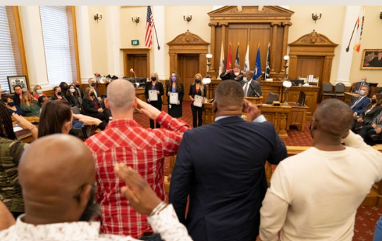
Innovations in Criminal Justice
(Veterans Treatment Court)
Collaborative Approach:
  Riverside County District Attorney
  Riverside County Superior Court
  Probation Department
  Department of Veterans Affairs
  RUHS
  Public Defender
Eligible individuals are former members of the United States military AND suffer from a mental health problem or substance abuse.
Program length: 12-18 months.
Several hundred graduates of the Program.

Slide 11
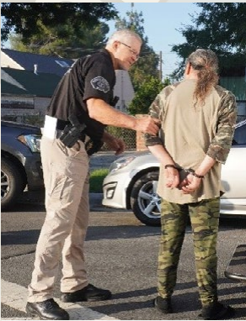
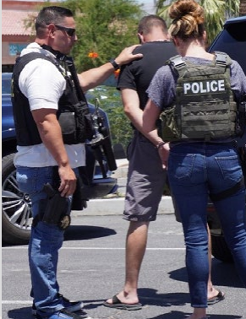
Countywide Task Forces
Riverside County Child Exploitation Team
(RCCET)
 | 2020 | 2021 | Total
Cyber Tips Received | 2,602 | 3,874 | 6,476
Search Warrants | 587 | 468 | 1,055
Arrests | 99 | 149 | 248

Slide 12
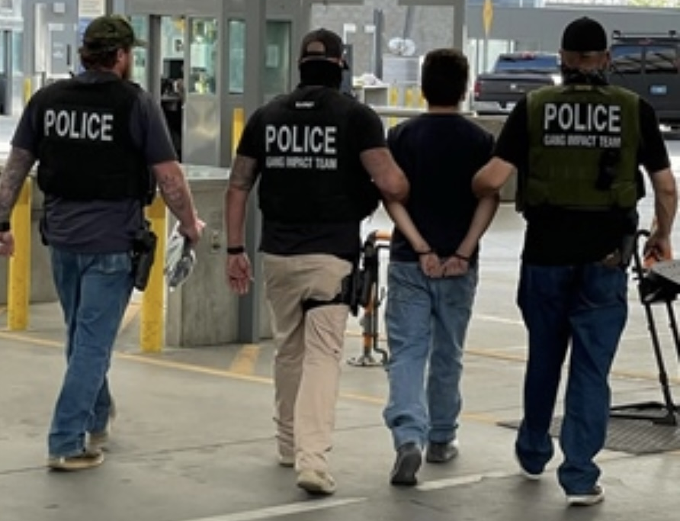
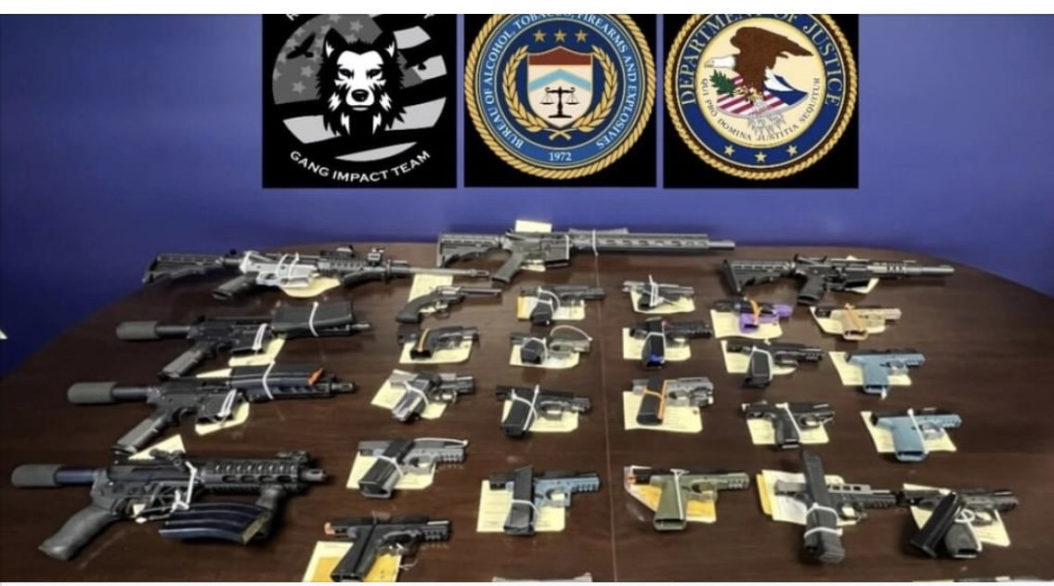
Countywide Task Forces-Gang Impact Team (GIT)
Period | Homicide Arrests | Total Arrests | Guns | Meth | Heroin | Cocaine | Fentanyl | Pills
FY 2015-YTD | 105 | 1,407 | 1,087 | 1,995 lbs. | 7 lbs. | 46 lbs. | 2,622 lbs. | 75k

Slide 13
Challenges
Criminal Caseloads
Covid-19 Recovery
Legal Mandates
Body Worn Camera

Slide 14
COVID RECOVERY CASELOAD EFFECT

Slide 15
Unfunded Legal Mandates*
SB 483 – Resentencing process to eliminate prison priors
SB 1437 - Murder
SB 1393 - Reducing sentences for serious/violent felons
SB 384 - Tiered sex offender registration
SB 620 - Using a firearm in the commission of a crime
Prop 66 - Death Penalty
AB 1950 - Retroactive Reductions in Probationary Terms
SB 1421 - Public Records Act Peace Officer Requests
AB 124 - Expand the Process for Vacating Convictions
AB 256 - Retroactive treatment of California Racial Justice Act
AB 1127 - Prohibition of Juvenile Adjudications from Strike Priors
AB 1245 - Permit a 15 yr. time served for petition, recall and resentencing
AB 1987 - Post conviction discovery issues
* This is only a snapshot, not a comprehensive list

Slide 16
EVOLUTION OF THE DA
Body Worn Cameras

Slide 17
Approp 1
90%
Salaries/Benefits
Temporary Staff
Buy down/Payoffs
Approp 2-7
10%
Services/Supplies
ISF/Contracts/Utilities
Equipment/Furniture
Revenues
Prop 172
Federal Pass thru
State/Local
Sub-Fund Revenue
The Breakdown of the District Attorney’s Budget

Slide 18
FY 21/22 - Current Status-update
Requested NCC: $86.3M
Current NCC Allocation: $86.3M
REMAINING DEFICIT: $0M
PROJECTED DEFICIT: $0M
PROJECTED Surplus: $0.8M

Slide 19
FY 22/23 Fiscal Overview
Requested NCC: $97.1M
Current NCC Allocation: $86.3M
EO Recommendation (Prop 172) $7.2M
ADDITIONAL NCC NEEDED:
Critical Backfills/Mandates $3.6M
FY 21/22 PROJECTED Surplus: $0.8M

Slide 20
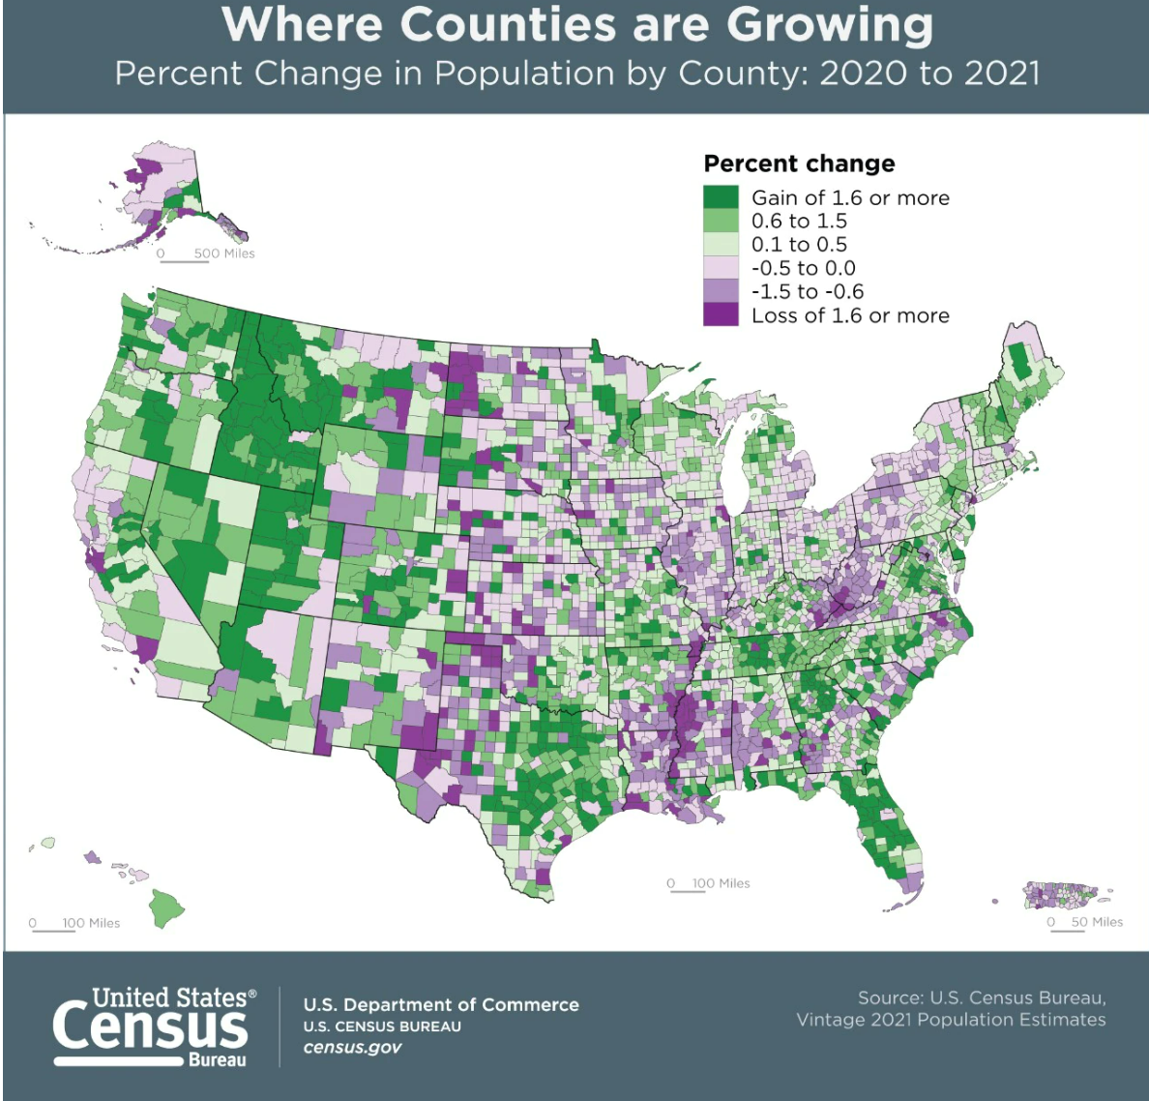
POPULATION GROWTH

Slide 21
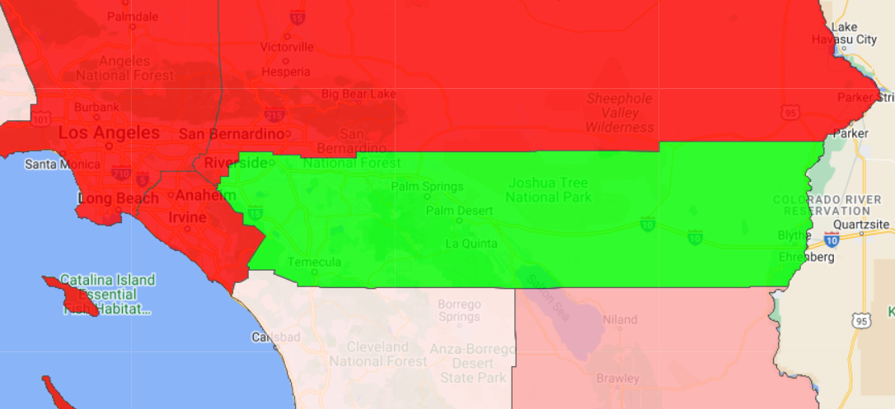
DESIREABILITY OF RIVERSIDE COUNTY
Gained Population from:
  Los Angeles County: 162,000
  Orange County: 129,000
  San Diego County: 61,177
Gained Wealth from:
  Los Angeles County ($6.14b)
  Orange County ($4.98b)
  San Diego County ($2.82b)
RIVERSIDE COUNTY
Source: www.howmoneywalks.com/irs-tax-migration

Slide 22
Rising Population - Decreasing Staff

Slide 23
FY 22/23 Fiscal Overview
Requested NCC: $97.1M
Current NCC Allocation: $86.3M
EO Recommendation (Prop 172) $7.2M
ADDITIONAL NCC NEEDED:
Critical Backfills/Mandates $3.6M
FY 21/22 PROJECTED Surplus: $0.8M

