Slide 1

Riverside County
Integrated Service Delivery Transformation Initiative
Board of Supervisors’ Budget Hearing
June 13, 2022

Slide 2



What are we trying to change?
Many Riverside County residents are not getting needed services and supports at the optimal time and place for achieving positive outcomes.
When residents receive services and supports, Riverside County focuses on addressing the presenting need or complaint, but often misses the chance to assess other needs, risks and resource opportunities.
Residents with complex challenges receive services and supports in a fragmented manner.

Slide 3
What does change look like?
Goals
Strengthen prevention and early intervention services
Improve service experience for Riverside County residents who have complex needs
Guiding Principles
Connectivity
Alignment
Adaptability
Efficiency
Accountability

Slide 4




How will we know
we have succeeded?
Integrated Service Delivery Targets
Will Be Met
Riverside County’s
Healthy Places Index Position Will Rise
Whole Person Health Scores
Will Improve

Slide 5
Where have we been?
Board Resolution
Countywide Launch
Collective Impact
Infrastructure
Pilot Design Thinking
Oct 2021
Dec 2021
Feb 2022
April 2022
May 2022
Vision, Goals, Principles
Completed &
SB 1054 Introduced to Improve Child Welfare & Adult Protective Data Sharing
AB 2083 Integrated Services Delivery MOU &
Board Resolution Approved
Jurupa Valley Community
Health Center
Pilot Design Launched
Executive Steering Committee and Workgroups Established
Office of
Service Integration
Established

Slide 6
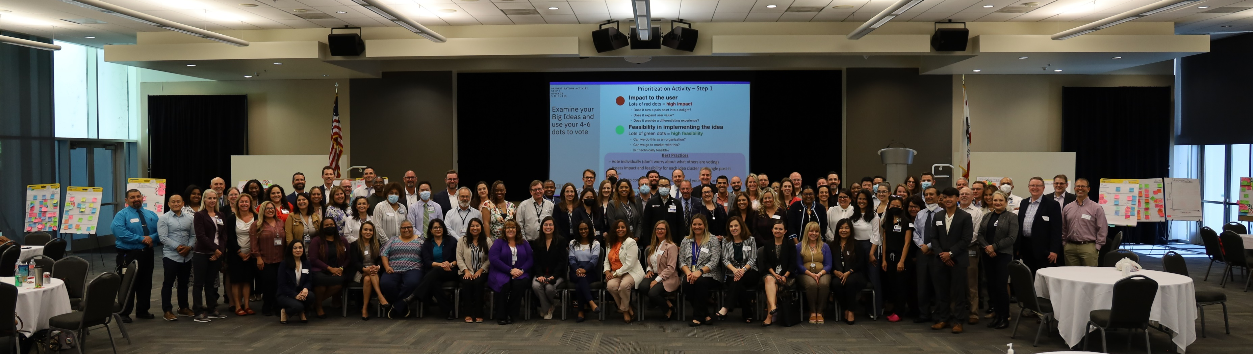
How will services be integrated?
Universal application of the Whole Person Health Assessment
Universal Intake
Multi-Modal Access to Services
Community Services Navigation
Data Sharing
Closed Loop Referral Processes
Coordinated Service Plans

Slide 7

What Are Our Tools for
Making Change?
FY 22-23
$3 M
Budget
Policy & Practice Changes
Transformed Service
Countywide Support from the
Office of Service Integration
Systems Navigation Services
Contracted Services:
(Legal Counsel; Facilitation
Technology Infrastructure)
Integrated Care Coordination & Information Sharing
Resident Outreach
Resident Engagement (Research)
Workforce Development, Preparation & Training
Customer Partner Support
Communication Strategies & Change Management Tools
User-Friendly Service Interfaces

Slide 8

Jurupa Valley
Community Health Center
Pilot
Place-Based Approach
Location: Comprehensive, High-Volume Clinic in a low HPI Community*
Context: Holistic and Family Well-Being
Outreach
Assessment
Intake
Access
Coordination
Presenting Customer
Practice Change:
Relevant Family Members
Multi-Disciplinary Team Approach in Alignment with
AB 2083
Aging – Master Plan
CalAIM
Multi-Disc Teams
Step 1: Whole
Person Health Scores
Practice Change
Step 2: Risk-
Screening
Practice Changes: Improving pathways to a suite of services
Primary Healthcare
Approach
Clients’ social & economic needs contextualized as social determinants of health
Intake recognizes the resources & stressors inherent in clients’ personal relationships
Reduction in paperwork, travel and need to repeat personal information
Reduction in conflicting or redundant service provision, guidance & support
Clients will be identified in a less stigmatized setting
Experience
* HPI: Serving as analytic predictor of poor health and well-being outcomes

Slide 9
How will we get there?
Collective Impact
Staff Engagement
Testing
Early Wins
Scaling Up
June 2022
July 2022
Sep 2022
Dec 2022
2023-2024
Disseminate Design Thinking Findings
Identify Pilot Strategies
Prepare Multi-Departmental Team to execute Pilot
Test Pilot Strategies
Planning and Implementation at 4 New Sites
Resource Development & Deployment
Evaluation & Practice Dissemination
Workforce Development
Policy Setting

Slide 10
How does the customer experience integrated services?
The Baker Family

