Slide 1


Fiscal Year 2022/23
Budget Hearing
Board of Supervisors Meeting
Agenda Item 1.1
June 13, 2022

Slide 2

Budget Hearing Schedule
Open the Hearing
          Executive Office Overview
          Department Presentations
          Public Comment
          Board Discussion
          Submission of Written Revisions
Close the Hearing
Board Deliberation
Approve the Recommended Budget, or
Provide Direction to the Executive Office
FY22/23 Budget Hearing (June 13, 2022)
Notes:
Word about department presentations:
Other departments are in chambers and attending via Zoom
Available for questions
Word about schedule:
Published times are approximate
Departments will be ready to go sooner if necessary
Hearing can last today, tomorrow, and a future date if necessary
Thanks to Departments & Team:
Dave Rogers
Michael Ambolo
Frankie Ezzat
Stephanie Persi
Dolores Reyna
Venus Brambila
Don Kent
Juan Perez
Rania Odenbaugh
Brooke Federico

Slide 3
Board Action
Government Code section 29063:
    Must adopt the recommended budget by June 30th
    May make revisions to recommended budget until budget adopted
          But … a revision to the recommended budget after the start of the public hearing shall be made only if:
                the revision is in writing, and
                filed with the Clerk of the Board prior to the close of the hearing
          Otherwise, a revision requires a four-fifths vote of the Board after the close of the hearing
FY22/23 Budget Hearing (June 13, 2022)
Notes:
So… Don’t close the hearing until all revisions submitted by Board or EO in writing to COB first.

Slide 4
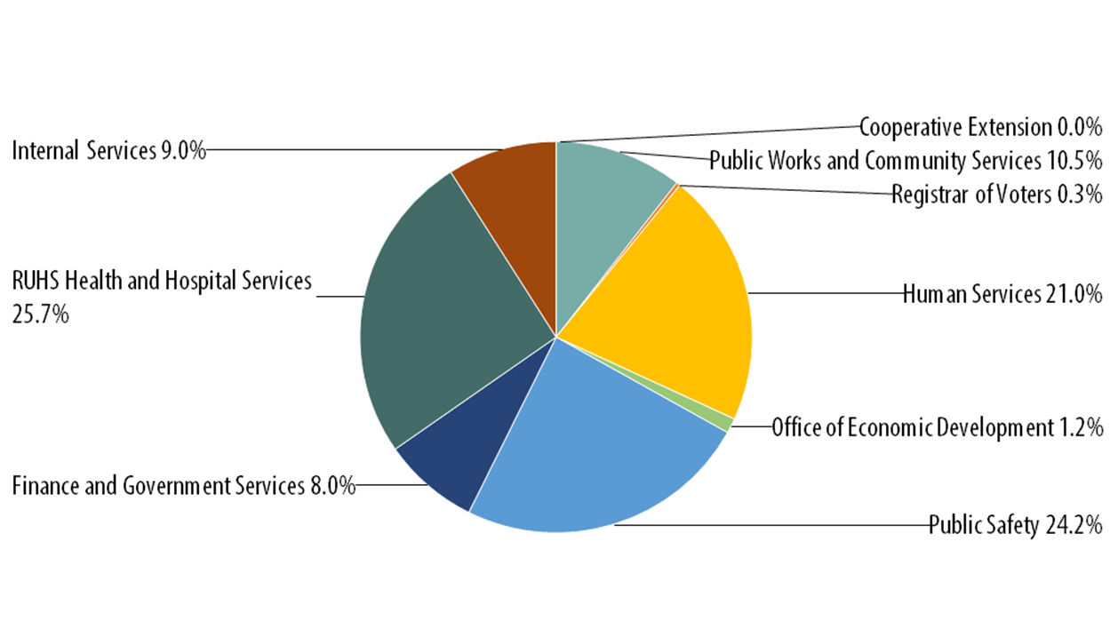
The Big Picture
$7.5 billion in Appropriations
    Expenditures by Function:
    Health & Hospital Services:
    $1.9 billion
    12.2% increase year over year
    Public Safety:
    $1.8 billion
    7.3% increase year over year
    Human Services:
    $1.6 billion
    6.1% increase year over year
    Public Works & Community Services:
    $785 million
    9.8% increase year over year
    Finance & Government Services:
    $594 million
    8.3 % increase year over year
FY22/23 Budget Hearing (June 13, 2022)

Slide 5
Ongoing Budget Strategies
    Reduce structural deficit
    Maintain healthy general fund reserve
    Minimize impacts to services
    Continue robust pandemic response and recovery efforts, but don’t rely on one-time revenue for ongoing expenses
    Create augmentation fund to support priorities and policy decisions
FY22/23 Budget Hearing (June 13, 2022)
Notes:
Reduce NCC deficit from operations
Maintain healthy general fund reserve
Above floor set by Board policy (25% of discretionary revenue)
Would like to get two months costs
Minimize impacts to services
Continue robust COVID-19 response and recovery efforts
More at the end of this overview
Create augmentation fund

Slide 6
Ongoing Budget Strategies
    Work to balance internal support needs with costs
    Establish greater employee position control
    Look for efficiencies and innovation in service delivery
    Create a countywide performance unit and report progress
    Generally, keep FY22/23 general fund allocations at FY21/22 levels,
    with departments absorbing labor and pension cost increases
FY22/23 Budget Hearing (June 13, 2022)
Notes:
Keep internal service costs flat
Establish greater position control
Budget controls in place
Reduced number of vacant unfunded positions with more to come
Still working on a way to show the information that matters in a way that can be understood. (How many filled? How many funded? How many net new budgeted?)
Look for efficiencies
Internal efforts taking root
Additional work to be done
Countywide performance unit
Generally keep NCC flat

Slide 7
Discretionary General Fund: Recommended Budget (in millions)
 | Recommended
Projected Beginning FY 22/23 Reserves | $ 368
Discretionary Revenue | 1,013
Discretionary Expenses | 1,013
Includes: $19.7 million for the Augmentation Fund $5 million for the Unincorporated Communities Initiative $20 million for Contingency
Net Deficit from Operations | 0
Projected Ending FY 22/23 Reserves | $ 368
FY22/23 Budget Hearing (June 13, 2022)

Slide 8
Discretionary General Fund: Highlighted Increases to Departments
Department | Increase | Reason
Agricultural Commissioner | $ 224,190 | Close funding gap and allow for increased draw down of external funds
Assessor Clerk Recorder | 1,500,000 | Begin a 5-year plan to balance revenue and expenses
Auditor Controller | 886,353 | Increase staffing to implement recommendations
Behavioral Health | 113,590 | Funding to balance salary and benefits increases
Clerk of the Board | 457,000 | New/upgraded management system, digitize records, remodel of Assessment Appeals Board room for virtual hearings, addition of two staff members
DPSS | 16,026,789 | Expiration of CalFresh waiver, increase in IHSS maintenance of effort costs, increase to social worker salaries, fund program to house at-risk youth
Fire | 2,500,000 | Extend approved funding for surge staffing into new fiscal year
Housing & Workforce Solutions | 250,000 | Fund new position for homelessness response coordination
Office of Economic Development | 435,711 | Funding for increased EIFD efforts
Office on Aging | 533,985 | Matching funds to draw down supplemental ARPA funding
Parks & Open Space District | 82,532 | Funding for coordinator position
Public Health | 3,098,454 | Funding for California Children’s Services, funding for Deputy Director position
Registrar of Voters | 2,106,495 | Costs associated with Voters Choice Act
TLMA: ALUC | 52,000 | Start-up funding for projects
TLMA: Code Enforcement | 500,000 | Extend approved funding for seven-day workweek into new fiscal year
Treasurer Tax Collector | 400,000 | Avoid layoffs and begin to cover costs associated with loss of CREST funding
Unincorporated Communities Initiative | 2,000,000 | Extend approved funding for additional UCI into new fiscal year, bringing the total to $5 million
Veterans Services | 156,384 | Extend approved funding for additional positions into new fiscal year
Fiscal Year 2022/23 Recommended Budget Preview (May 2, 2022)
Notes:
Committed to Board to:
Work closely with Department to understand their requests
Acknowledge that not all requests can be funded
Differentiate “needs” vs. “wants”
Balance “needs” vs. “needs”
Make tough choices
Develop recommendations for the Board
Other highlights based on Supervisor feedback at workshop:
Public Safety ACEO; RivCoTV Coordination; Modesty Panel in Chambers
Grant Writer / Coordinator
Addressing Staff Shortages (Nursing, Other)
Fight Homelessness; HWS Staffing; Grant Writer / Coordinator; Staffing Shortages (Planning)
Innovate and Tighten Up

Slide 9
COVID-19 Relief & Recovery Funding
Recommended budget does not rely heavily on coronavirus funds for County operations:
Coronavirus Aid, Relief, and Economic Security Act (CARES)
            All funds have been expended as of Fiscal Year 2021/22
            Final report coming soon to the Board
American Rescue Plan Act (ARPA)
            $479 million to the County of Riverside
            Board direction to develop an equitable spending plan focused on supporting public health, laying foundation for strong economic recovery, investing in infrastructure, and strengthening community resilience, while limiting the amount of funding going to support County operations.
            First round of $239 million received in May of 2021 and Board approved spending plan
            Second round of $239 million received in June of 2022 and we are in the early stages of developing a spending plan
            It is anticipated that less than 10% of the total funding will go to support County operations
FY22/23 Budget Hearing (June 13, 2022)

Slide 10
Discretionary General Fund: Unincorporated Communities Initiative
$5 million set aside for:
          Further investment in the unincorporated areas
          Support additional services or infrastructure projects
          Supplements other funding mechanisms
          One-time costs or ongoing operations*
          *Could increase costs in future years if used for ongoing operations
FY22/23 Budget Hearing (June 13, 2022)

Slide 11
Discretionary General Fund: Augmentation Fund
$19.7 million set aside for:
          Board priorities and initiatives
          Supplemental requests from departments
          Items identified during public comment
          One-time costs or ongoing operations*
          *Could increase costs in future years if used for ongoing operations
FY22/23 Budget Hearing (June 13, 2022)

Slide 12
Other Funding Sources: Highlighted Increases to Departments
Department | Increase | Reason
District Attorney | $ 7,240,823 | Funding to balance salary and benefit increases and for new Homeless Court program
Emergency Management | 1,549,000 | Funding to balance lost revenue from Fire contract
Fire | 19,788,359 | Funding to balance cooperative agreement increases and for Temecula cost sharing, municipal staffing, relief positions, hoses & nozzles, and station remodels/expansions
Probation | 2,181,897 | Funding to balance lost revenue from elimination of fines and fees and for new Homeless Court program
Public Defender | 3,457,178 | Funding to balance salary and benefit increases and for new Homeless Court program
Sheriff | 36,204,557 | Funding to balance salary and benefit increases and for increase in unincorporated patrol, additional coroner positions, lost revenue, portion of new staffing for Lake Matthews staffing, and portion of new projects and purchases
FY22/23 Budget Hearing (June 13, 2022)
Notes:
Other highlights based on Supervisor feedback at workshop:
Remodeling Fire stations, Surge Capacity

Slide 13
Fiscal Pressures
  Economic forecast is uncertain and impact is unknown
  Solving retention and recruitment issues will cost money
  Need to pay for deferred/delayed maintenance projects
  Visionary priority capital improvement projects could become a reality
  Increasing demand for new and improved services
  Reset boundaries due to redistricting
FY22/23 Budget Hearing (June 13, 2022)

Slide 14
Back to Board Action
Government Code section 29063:
    Must adopt the recommended budget by June 30th
    May make revisions to recommended budget until budget adopted
          But … a revision to the recommended budget after the start of the public hearing shall be made only if:
                the revision is in writing, and
                filed with the Clerk of the Board prior to the close of the hearing
          Otherwise, a revision requires a four-fifths vote of the Board after the close of the hearing
FY22/23 Budget Hearing (June 13, 2022)
Notes:
So… Don’t close the hearing until all revisions submitted by Board or EO in writing to COB first.

Slide 15
Questions
FY22/23 Budget Hearing (June 13, 2022)

Slide 16
Discretionary General Fund: Increased Revenue Projections
FY22/23 Budget Hearing (June 13, 2022)

Slide 17
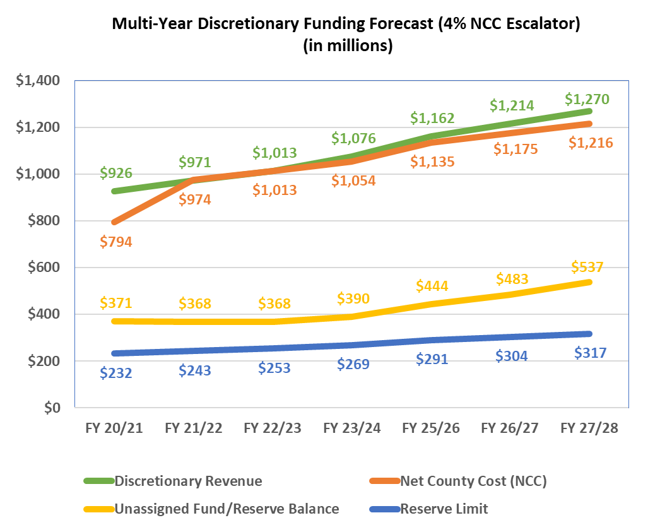
Discretionary General Fund: Multi-Year Forecast
FY22/23 Budget Hearing (June 13, 2022)

Slide 18
Requests for Supplemental Funding
Department: Request | Amount | Board Decision
TOTAL | $ | $ --.--
FY22/23 Budget Hearing (June 13, 2022)

Slide 19
Proposed Revisions Submitted in Writing to COB
Source: Request | Amount | Board Decision
TOTAL | $ | $
FY22/23 Budget Hearing (June 13, 2022)

Slide 20
Discretionary General Fund: Executive Office Detail
Fiscal Year 2022/23 Increase to EO NCC Targets
Program | Increase | (Decrease) | Reason
Courts: Criminal Justice Facilities | $ 639,678 |  | Administrative change, removed from debt service
Courts: Temporary Construction | 228,818 |  | Administrative change, removed from debt service
Courts: Unallowable Expenses |  | (9,499) | Reduction in costs
Debt Service / Capital Project Financing |  | (3,043,713) | Reduction and reassignment of debt service costs
EO Legislative & Administrative Support | 2,549,873 |  | Support Opioid / Fentanyl Campaign, loan for Salton Sea pending revenue
EO Operations | 1,100,000 |  | Extend approved funding for audit / special project position to new fiscal year (FY21/22 Budget Hearing Augmentation) Fund three new positions: ACEO for Public Safety, DEI Officer, Analyst
Indigent Defense: Court Reporter Transcripts |  | (427,895) | Reduction in costs based on review of historic actuals*
Indigent Defense: Attorney Contracts | 540,000 |  | Increase costs associated with state mandates and COVID closure of courts*
Mead Valley Infrastructure Fund | 6,000 |  | Revenue calculation increase
Total: | $ 5,064,369 | $ (3,481,107) | NET: $ 1,583,262
Fiscal Year 2022/23 Supplemental EO NCC Requests
Program | Increase | (Decrease) | Reason
Courts: State Trial Courts Maintenance of Effort | $ 243,335 |  | Increase to required cost sharing
Courts: Court facilities ISF increases | 2,055,578 |  | Increase to required cost sharing
NPDES | 16,998 |  | Increase to costs
Total: | $ 2,315,911
FY22/23 Budget Hearing (June 13, 2022)

