Slide 1

Fiscal Year 22/23 Budget Brief
June 13, 2022

Slide 2
Agenda
Year Three
Current Fiscal Year 21/22 budget status
Ongoing Efficiencies
Hiring Trends (Laterals)
Fiscal Year 22/23 Budget Request
BCTC Master Plan
Future RSO Concerns
Summary

Slide 3
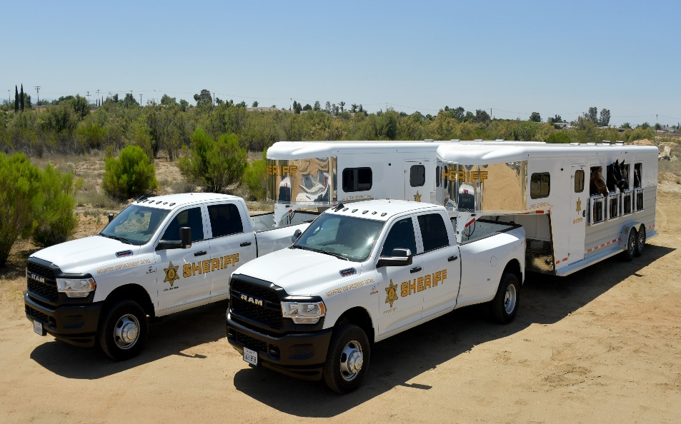

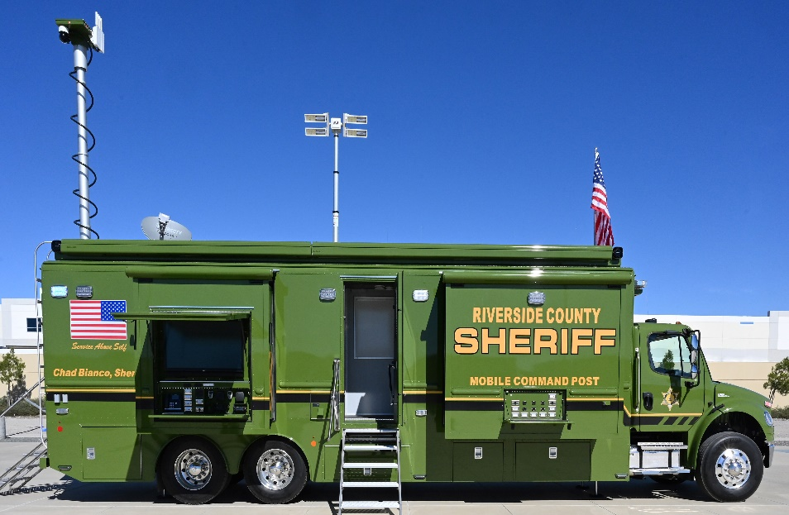
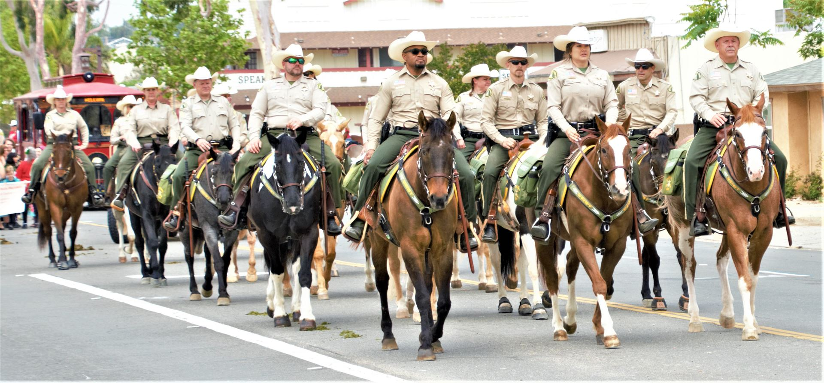
Year Three

Slide 4
Current Year Budget Status
Current budget was adopted with structural deficit
Original structural deficit eliminated thru department efficiencies and ATTRITION
Academy training at Ben Clark Training Center has ramped up
Hiring of laterals has saved on training costs
We are on track to end FY 21/22 with a balanced budget

Slide 5
Ongoing Efficiencies
Court Deputy Classification
PSEC / Fleet
Lateral Hires
Liability and Risk Management
Alternatives to Sworn Deployment
Exchanging positions to Classified
Corrections Transition

Slide 6
County Population
Data Prepared by: Demographic Research Unit
California Department of Finance
Notes:
Data Prepared by:
Demographic Research Unit
California Department of Finance

Slide 7
RSO Filled Positions
FY07/08 to FY21/22
Sworn 1,704/CD’s 1,129/1,085 Classified
Notes:
Based on FY 21/22 PP12-22, Jill’s reports IC
Jill’s report
FY 18/19 Based on PPD 6- 3,528 Filled. Reduced by 12 to match Net Gain of 239 positions since Sheriff took office

Slide 8
Personnel Hires/Losses
July 2nd 2021 thru June 1st 2022
Personnel | Attrition | Hires | *Net Gain/Loss
Sworn | -145 | 142 | -3
CD | -73 | 197 | 124
Classified | -113 | 151 | 38
Total | -331 | 490 | 159
Notes:
Updated from Jill’s PP12 report IC

Slide 9
Lateral Hires
Advantages to hiring a laterals:
A new Deputy Sheriff Trainee (DST) requires 1,800 hours of training prior to becoming productive
A Lateral Deputy hire requires approximately 500 hours of training prior to becoming productive
This fiscal year we have hired 65 Deputy Sheriff laterals
This saves the County over 85,000 hours of unproductive time
The estimated savings is approximately $3M

Slide 10
FY 22/23 Prop 172 Funding
Prop 172 | Amount
FY 22/23 CEO Prop 172 allocation | $145.4M
FY 22/23 Additional Prop 172 (permanent) Mou, Pension and ISF-$10.9M Unincorporated Staffing Initiative-$7.3M (60 Sworn) Lake Mathews stn (Partial Funding) $10.1M (70 psns) Coroner’s Bureau (staffing and equipment) $740k | $29M
FY 22/23 Prop 172 Partially fund projects and purchases | $5M
TOTAL Prop 172 CEO allocation | $179.4M

Slide 11
FY 22/23 CEO NCC Target
$378M
Notes:
IC – Updated with most recent summary’s information

Slide 12
FY 22/23 Requested Budget
We are submitting a budget that is $49M over CEO target:
CEO NCC Target - $378M
RSO Requested NCC - $427M
We are requesting the following for FY 22/23:
Field Operations (Patrol) - $19M
  Lake Mathews remaining funding request - $4.6M
  East End Aviation - $8M
  Replacement Helicopter $6.4M
Corrections Critical Staffing Plan - $14M
RSO operations- staff, services & supplies, and equipment- $16M
Notes:
IC – Updated with most recent summary’s information

Slide 13
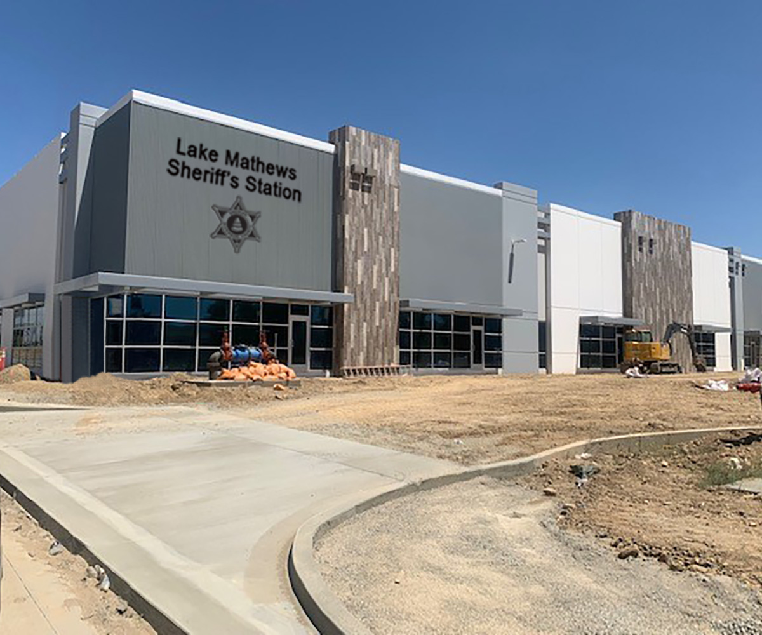
Lake Mathews Station

Slide 14
Lake Mathews Station
RSO serves the unincorporated communities of Home Gardens, Coronita, Lake Hills, Woodcrest, El Cerrito, Temescal Valley, Lake Mathews and Gavilan Hills
Population in that region is rapidly increasing
Currently three patrol stations cover this area
Response times can be impacted during highly congested commuter times
Lake Mathews station will eliminate the need for deputies to travel long distances and reduce response times
Requested Funding $4.6M

Slide 15
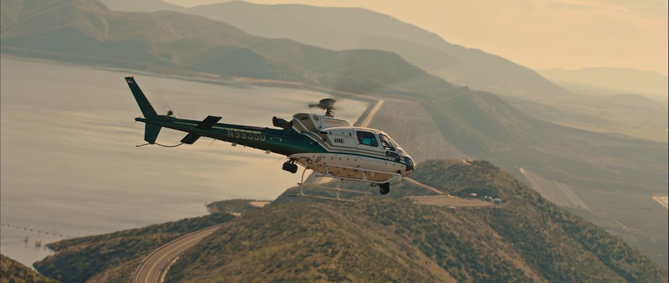
Star 9 East County Aviation

Slide 16
Star 9 East County Aviation
Dedicated deployment in the East county region
  Provide better air resource to deputies during calls for service
  In remote areas our aviation crews can respond quicker
    Provide better coordination with ground units to the location
    Can land during emergency assistance situations
Request funding for:
Helicopter: $6.3M (Financing is an option)
1 Sergeant and 6 Flight Crew: $1.4M
Additional fuel: $300,000
Total Requested Funding: $8M

Slide 17
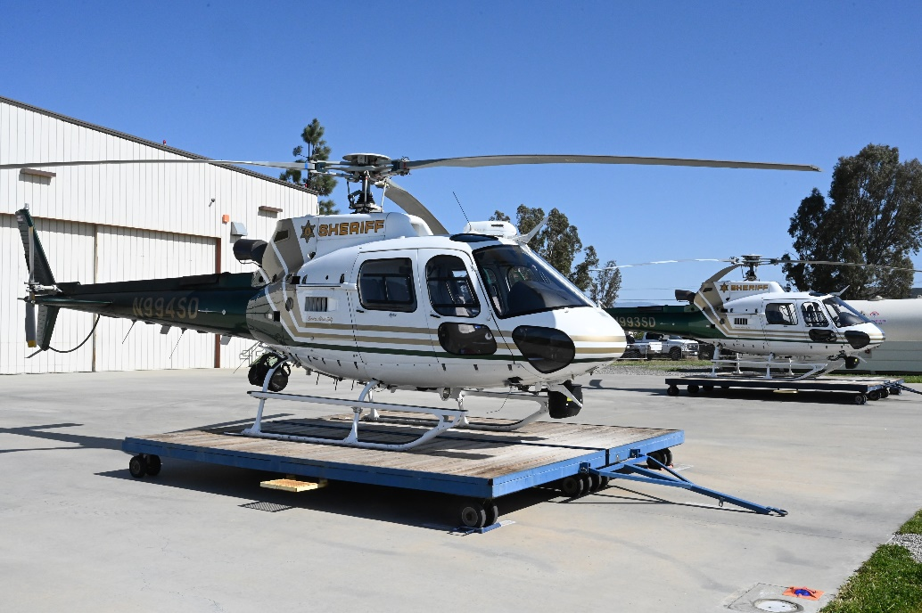
Star 9 Replacement

Slide 18
Star 9 Replacement
Every 12 years the H125 helicopters must undergo a full overhaul
An aging aircraft would be considered for replacement
Star 92 is approaching 22 years old and will be due in 2-years
Delivery of a replacement H125 is estimated at one year
Requested funding for a replacement helicopter is $6.4M

Slide 19
Corrections Staffing Needs
Governed by the Board of State Community Corrections (BSCC)
BSCC requires our jails to have adequate full time equivalent staffing levels to maintain the safety of the inmates and staff
We operate five jail facilities
Currently running on excessive overtime and have implemented mandatory overtime to comply with safe staffing levels
Current Overtime trend equates to 105 Correctional Deputy FTE’s

Slide 20
Corrections Staffing Needs
 | FY 22/23 Staffing Request |  | FY 23/24 Staffing Est | FY 24/25 Staffing Est | FY 25/26 Staffing Est | Total
Sworn | 3 |  | 5 | 0 | 0 | 8
Non-Sworn | 63 |  | 75 | 75 | 59 | 272
Classified | 1 |  | 42 | 43 | 42 | 128
Total | 67 |  | 122 | 118 | 101 | 408
Staffing Request | $7.3M |  | $12.8M | $12.4M | $10.8M | $43.3M
Operational Exp | $6.7M |  | $9.2M | $8.6M | $7.2M | $31.7M
Total Request | $14M |  | $22M | $21M | $18M | $75M

Slide 21
FY 22/23
RSO Operational Request
$16M
Support org $4.4M
  Additional support position due to growth and critically needed IT infrastructure upgrades
Patrol- $8.9M
Additional equipment, training and supplies
Court Services- $1.3M
Funding shortfall due to state allocation being inadequate
BCTC- $1.4M
Additional support position due to growth and training needs

Slide 22
Future RSO Concerns
Pension and ISF Costs
COVID-19/Civil Unrest
Federal/State Cuts/Prop 172
County Population Increase
BCTC Master Plan
Trial Court Funding - Service Level Exceeds State Allocation
AB 109/Jail Capacity/JBDC

Slide 23
FY 22/23 RSO Requested NCC
$427M
  RSO REQUEST
CEO TARGET
Notes:
IC – Updated with most recent summary’s information

Slide 24
Summary
Unexpected Emergencies will cause overtime to rise
We have a Jail with 1,200 empty beds
No JBDC request in this budget request
Department efficiencies are established and more are being implemented

